Slide 1
Connect Your Device to the Microsoft Azure IoT Hub
Azure IoT Hub & Azure Stream Analytics & Power BI

Slide 2
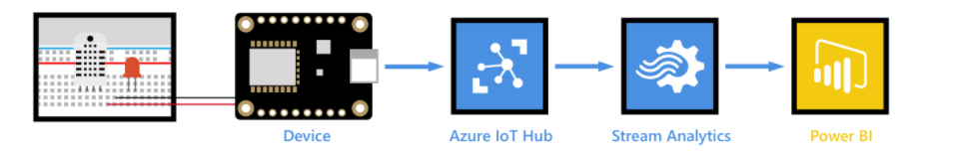
Arduino MKR WIFI 1010 to Azure IoT Hub
Connect a Arduino MKR WIFI 1010 board securely to Azure IoT Hub using an MQTT client.
Create a consumer group on your IoT hub.
Create and configure an Azure Stream Analytics job to read temperature telemetry from your consumer group and send it to Power BI.
Create a report of the temperature data in Power BI and share it to the web*.
https://docs.microsoft.com/en-us/azure/iot-hub/iot-hub-live-data-visualization-in-power-bi
Notes:
Used mainly these steps
https://docs.microsoft.com/en-us/azure/iot-hub/iot-hub-live-data-visualization-in-power-bi
This tutorial will walk you through how to connect a Arduino MKR WIFI 1010 board securely to Azure IoT Hub using an MQTT client.
Create a consumer group on your IoT hub.
Create and configure an Azure Stream Analytics job to read temperature telemetry from your consumer group and send it to Power BI.
Create a report of the temperature data in Power BI and share it to the web.
MQTT (Message Queuing Telemetry Transport) is a M2M (machine-to-machine) connectivity protocol which provides a messaging subscription and publish transport.

Slide 3
What is the cloud?
Before the cloud, when a company wanted to provide services to their employees (such as databases or file storage), or to the public (such as websites), they would build and run a data center.
This ranged from a room with a small number of computers, to a building with many computers.
Buying computers
Hardware maintenance
Power and cooling
Networking
Security, including securing the building and securing the software on the computers
Software installation and updates
This could be very expensive, require a wide range of skilled employees, and be very slow to change when needed.
A case: An online store needed to plan for a busy holiday season
Buying computers just for those moments, and sitting idle till the next
Notes:
For example, if an online store needed to plan for a busy holiday season, they would need to plan months in advance to buy more hardware, configure it, install it and install the software to run their sales process. After the holiday season was over and sales dropped back down, they would be left with computers they've paid for sitting idle till the next busy season.
✅ Do you think this would allow companies to move quickly? If an online clothing retailer suddenly got popular due to a celebrity being seen in their clothes, would they be able to increase their computing power quickly enough to support the sudden influx of orders?

Slide 4
Setting Up Azure Account & Registering our device

Slide 5
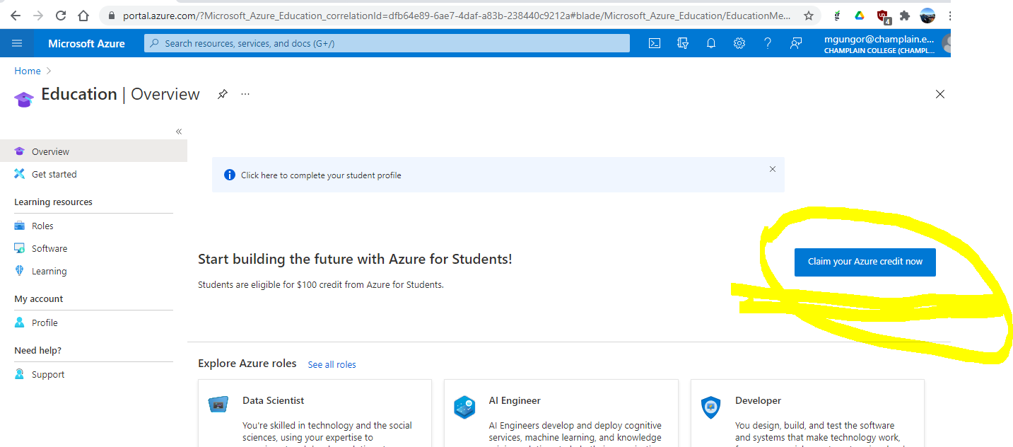
Create a Cloud Subscription
https://azure.microsoft.com/en-us/free/students/

Slide 6
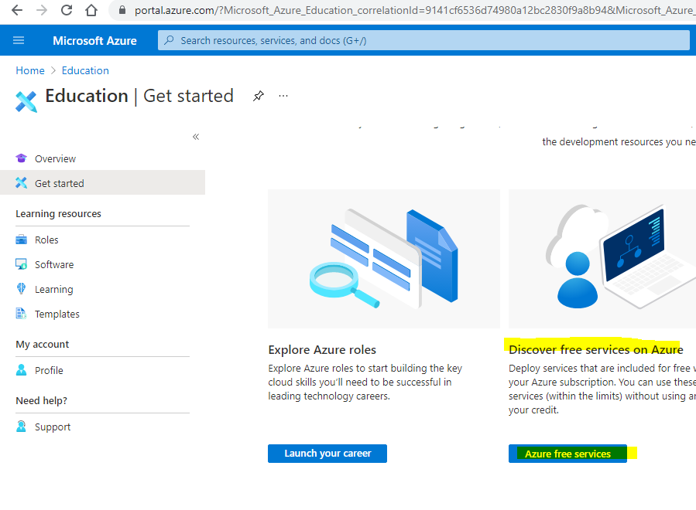
Azure free services
https://azureforeducation.microsoft.com/devtools
Notes:
Account information
Subscription ID: 77e53992-1b53-482d-b610-f9b54db83a77
Subscription name: Azure for Students

Slide 7
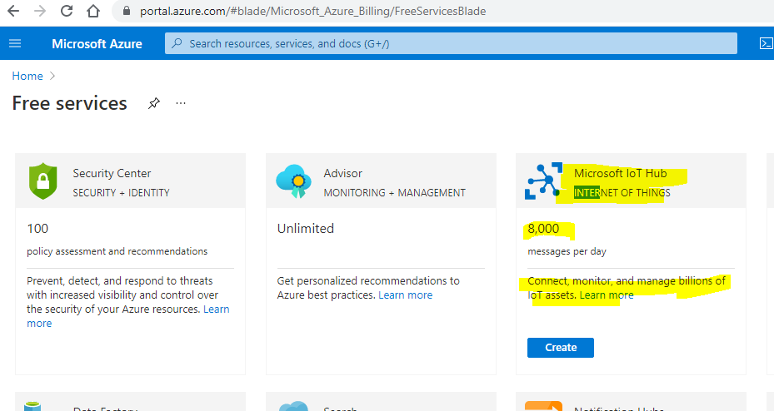
Create Microsoft IoT Hub
https://azureforeducation.microsoft.com/devtools
Notes:
Account information
Subscription ID: 77e53992-1b53-482d-b610-f9b54db83a77
Subscription name: Azure for Students

Slide 8
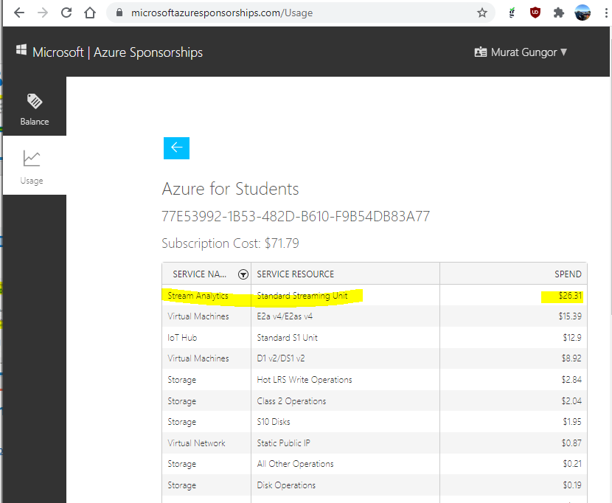
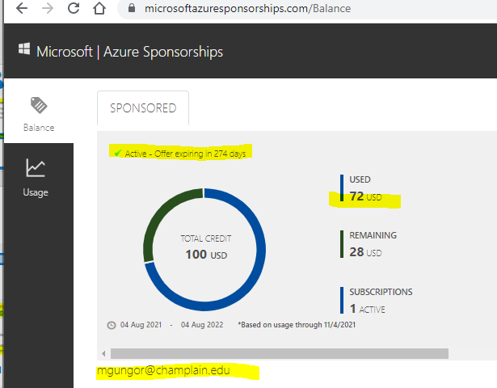
How to Check Your Account Balance
Microsoft | Azure Sponsorships
https://www.microsoftazuresponsorships.com
Check Your Balance
Get the most out of your sponsored account
Usage Details
Drill down into the usage statistics of your subscriptions

Slide 9
Connect your Device to the IoT service
Once the hub is created, your IoT device can connect to it.
Only added devices can connect to a service, so you will need to register your device first.
Notes:
When you register you can get back a connection string that the device can use to connect.
This connection string is device specific, and contains information about the IoT Hub, the device, and a secret key that will allow this device to connect.

Slide 10

What is Azure IOT Hub?
https://youtu.be/eEIPnYLj73A
Notes:
https://www.youtube.com/watch?v=eEIPnYLj73A

Slide 11
[Optional] – install the Azure CLI (Command Line Interface)
Azure Command-Line Interface
https://docs.microsoft.com/en-us/cli/azure/
Steps to Create an IoT service in the cloud
https://github.com/microsoft/IoT-For-Beginners/blob/main/2-farm/lessons/4-migrate-your-plant-to-the-cloud/README.md#task---install-the-azure-cli
Notes:
https://github.com/microsoft/IoT-For-Beginners/blob/main/2-farm/lessons/4-migrate-your-plant-to-the-cloud/README.md

Slide 12
Create IoT Hub and Resource Group

Slide 13
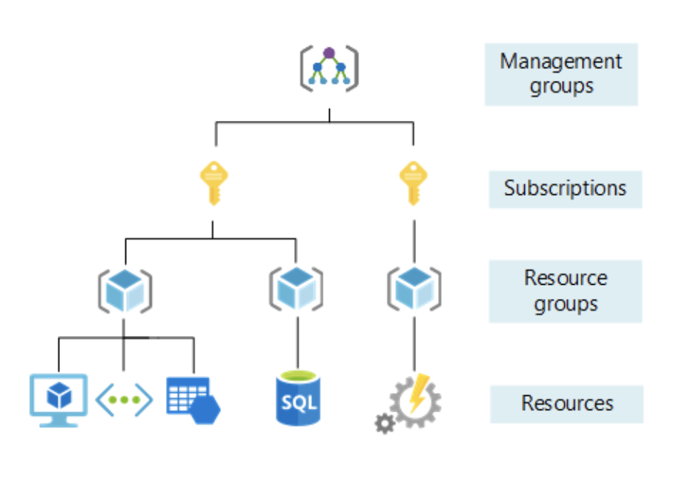
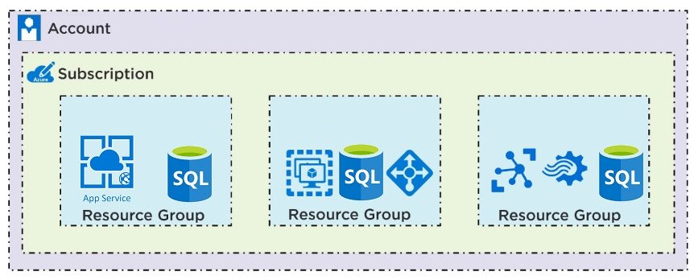
What is Resource Group?
Azure services, such as IoT Hub instances, virtual machines, databases, or AI services, are referred to as resources.
Every resource has to live inside a Resource Group, a logical grouping of one or more resources.
[Optional] If you like to user Azure CLI follow the steps at the link below
https://github.com/microsoft/IoT-For-Beginners/blob/main/2-farm/lessons/4-migrate-your-plant-to-the-cloud/README.md#task---create-a-resource-group

Slide 14
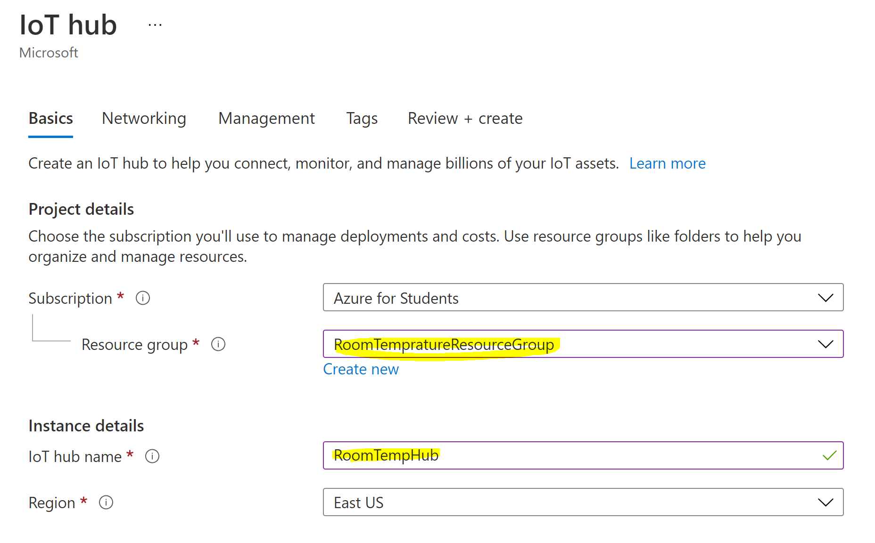
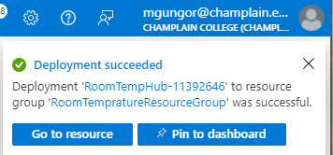
Name your IoT Hub and Resource Group
This will take several minutes be patient! Mine took ~4 Minutes
… Deployment is in progress
Notes:
Login to the Azure Portal and create an IoT Hub, name it whatever you want and put it in the region that makes sense for you, otherwise there isn’t too much to configure here.
RoomTempratureResourceGroup
RoomTempHub

Slide 15
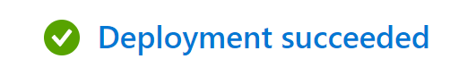
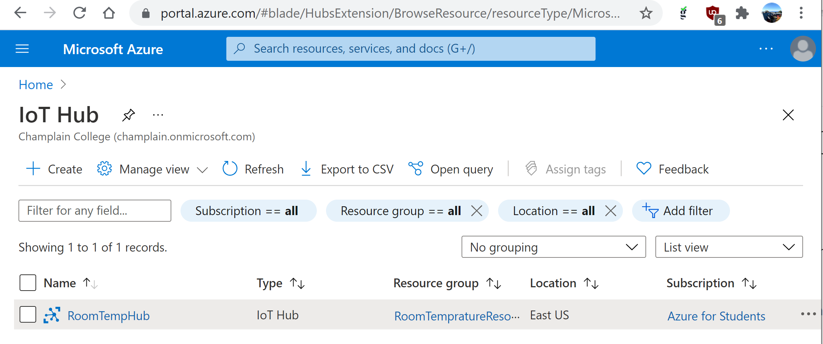
Completed! IoT Hub
You can now have an IoT Hub in your resource group.
Notes:
az iot hub create --resource-group soil-moisture-sensor --sku F1 --partition-count 2 --name <hub_name>
https://github.com/microsoft/IoT-For-Beginners/blob/main/2-farm/lessons/4-migrate-your-plant-to-the-cloud/README.md#task---create-an-iot-hub

Slide 16
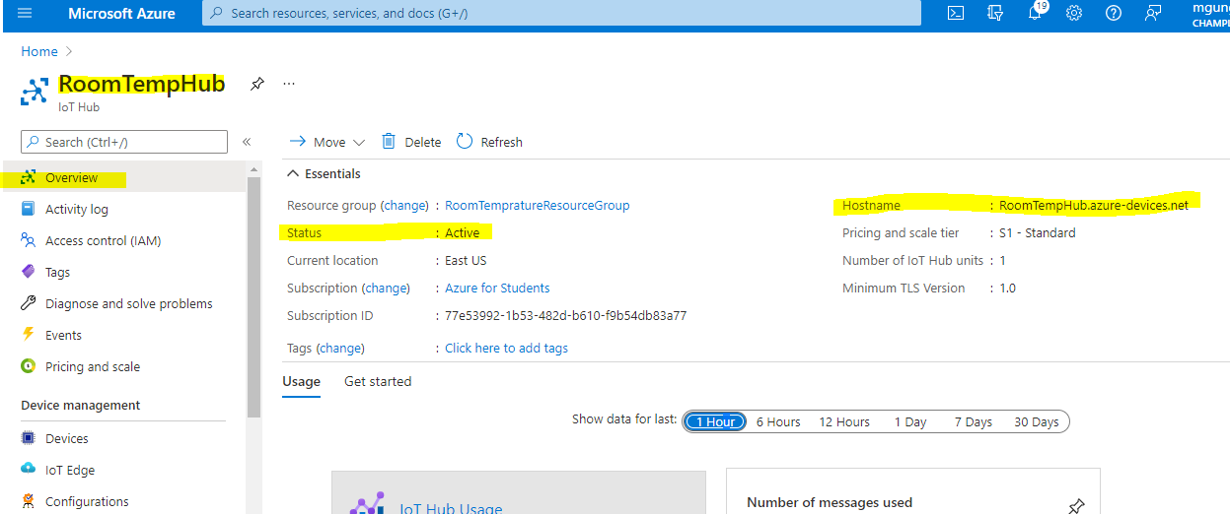
Navigate to your hub and look for the Hostname
The Hostname, this is your broker!

Slide 17
Add Device

Slide 18
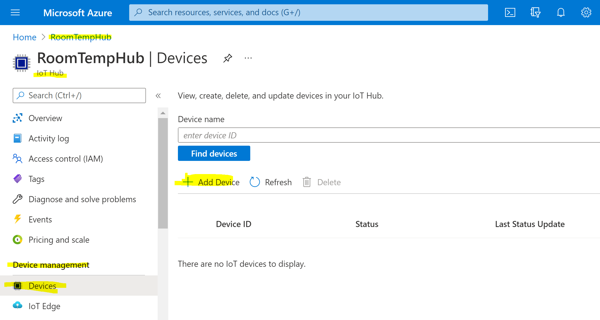
Task – Add Device to IoT Hub
Next we need to provision a device, look for “Devices” along the left side and select “Add Device”
Notes:
Run the following command to register a device:
az iot hub device-identity create --device-id <RESOURCE Group Name> --hub-name <hub_name>
Replace <hub_name> with the name you used for your IoT Hub.
This will create a device with an ID of soil-moisture-sensor.

Slide 19
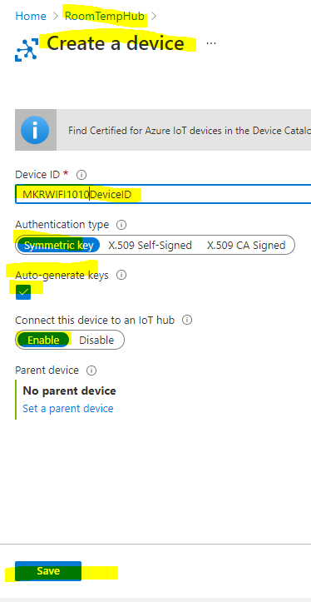
Adding a Device
Name the device,
Leave all other settings as default; authentication as “Symmetric key” and
Leave “Auto-generate keys” checked,
“Connect this device to an IoT Hub” enabled
and save.
Your Device ID is the MKRWIFI1010DeviceID.
Notes:
THIS IS GREAT
https://paul-bruffett.medium.com/iot-azure-pipeline-9725ac2b6a00
Run the following command to register a device:
az iot hub device-identity create --device-id <RESOURCE Group Name> --hub-name <hub_name>
Replace <hub_name> with the name you used for your IoT Hub.
This will create a device with an ID of soil-moisture-sensor.

Slide 20
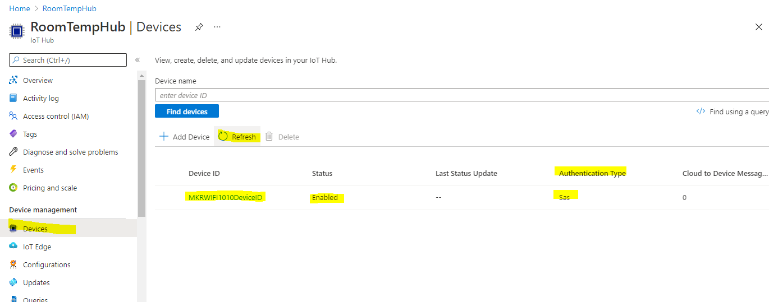
Device Added!
Refresh to see the newly added device
Your Device ID is the MKRWIFI1010DeviceID

Slide 21
Coding Part 1 Sending text message

Slide 22
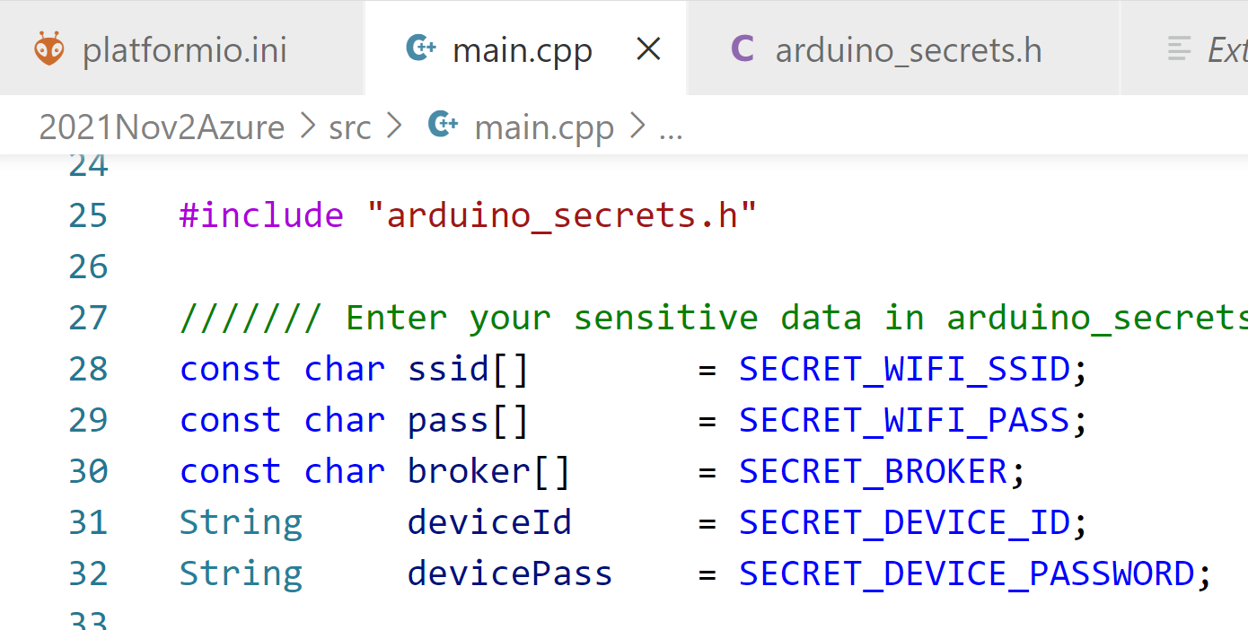



“arduino_secrets.h”
This contains information for connecting to
Wi-Fi Info => WE GOT THIS
MQTT broker => WE GOT THIS
Device ID => WE GOT THIS
Device Pass => WE NEED THIS
Notes:
In SlideCodes section – saved as ZIP file
01-SlideCode-SendingMessagesToAzure-VSCode.zip

Slide 23
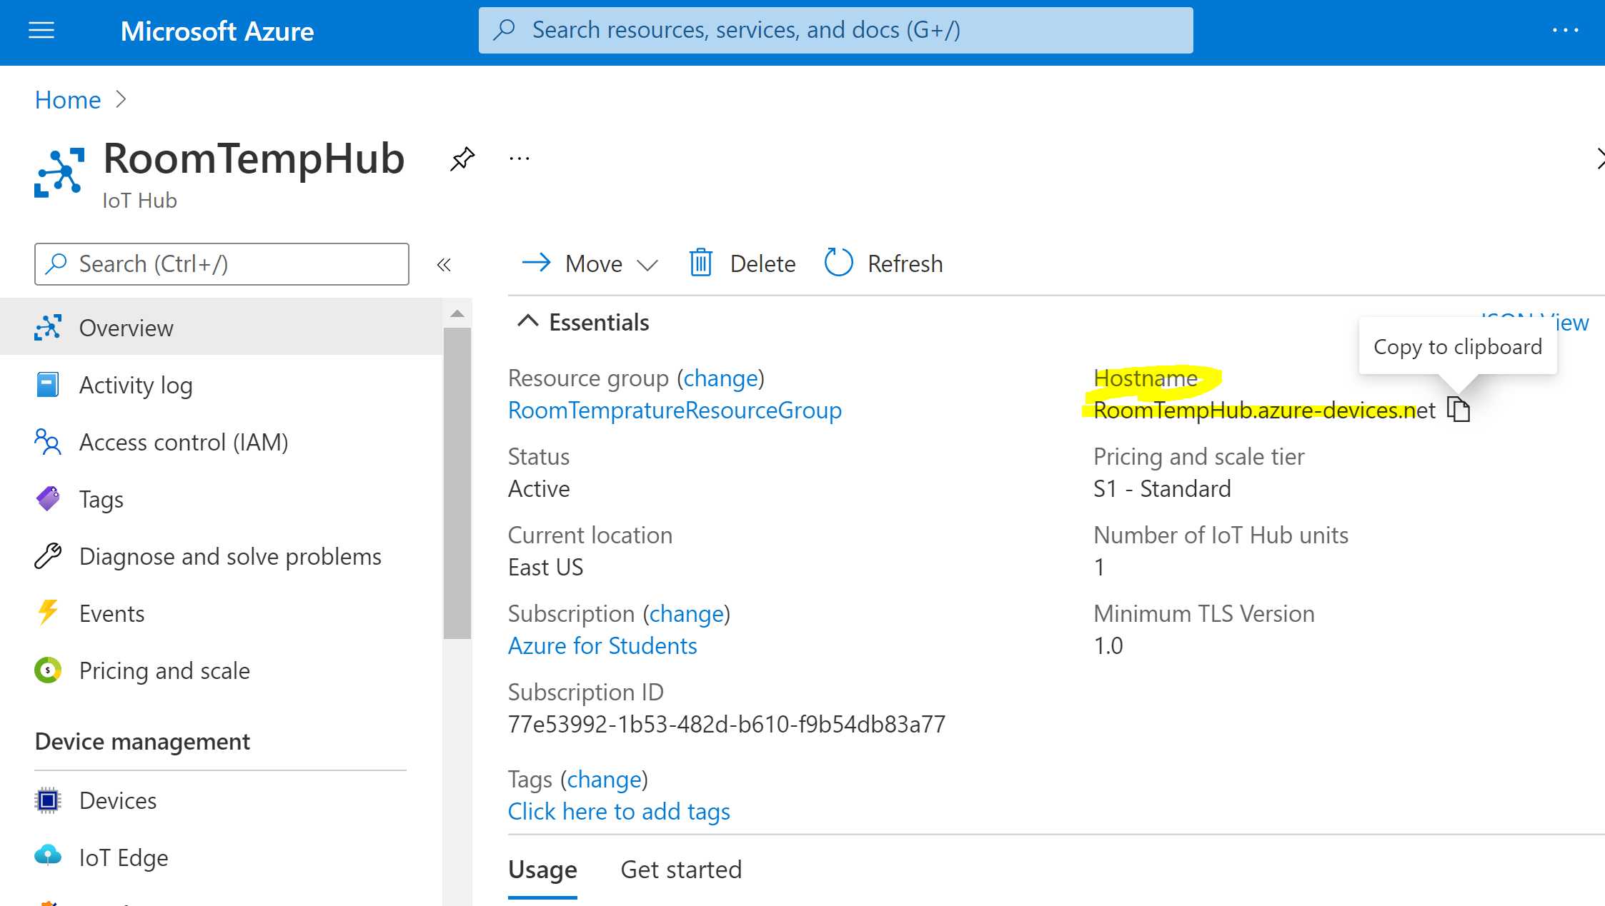
Partial My: arduino_secrets.h
Following is the secrets file content
Except WIFI info the rest should be different in your file
// Fill in your WiFi networks SSID and password
#define SECRET_WIFI_SSID "ChamplainPSK"
#define SECRET_WIFI_PASS "letusdare"
// Fill in the hostname of your Azure IoT Hub broker
#define SECRET_BROKER "RoomTempHub.azure-devices.net"
// Fill in the device id
#define SECRET_DEVICE_ID "MKRWIFI1010DeviceID"
// Fill in the device passoword
#define SECRET_DEVICE_PASSWORD "SharedAccessSignature sr=…….."
Notes:
// Fill in your WiFi networks SSID and password
#define SECRET_WIFI_SSID "ChamplainPSK"
#define SECRET_WIFI_PASS "letusdare"
// Fill in your WiFi networks SSID and password
#define SECRET_WIFI_SSID "GungorGuest"
#define SECRET_WIFI_PASS "welcomehome"
// Fill in the hostname of your Azure IoT Hub broker
#define SECRET_BROKER "RoomTempHub.azure-devices.net"
// Fill in the device id
#define SECRET_DEVICE_ID "MKRWIFI1010DeviceID"
// Fill in the device passoword
#define SECRET_DEVICE_PASSWORD "SharedAccessSignature sr=RoomTempHub.azure-devices.net%2Fdevices%2FMKRWIFI1010DeviceID&sig=e6vFR6c3Qw54DYV3IpWU66rnB%2B6wnAXOM6Dzlhv697I%3D&se=1637749921"

Slide 24
Shared Access Signature (SAS) as Device Password

Slide 25
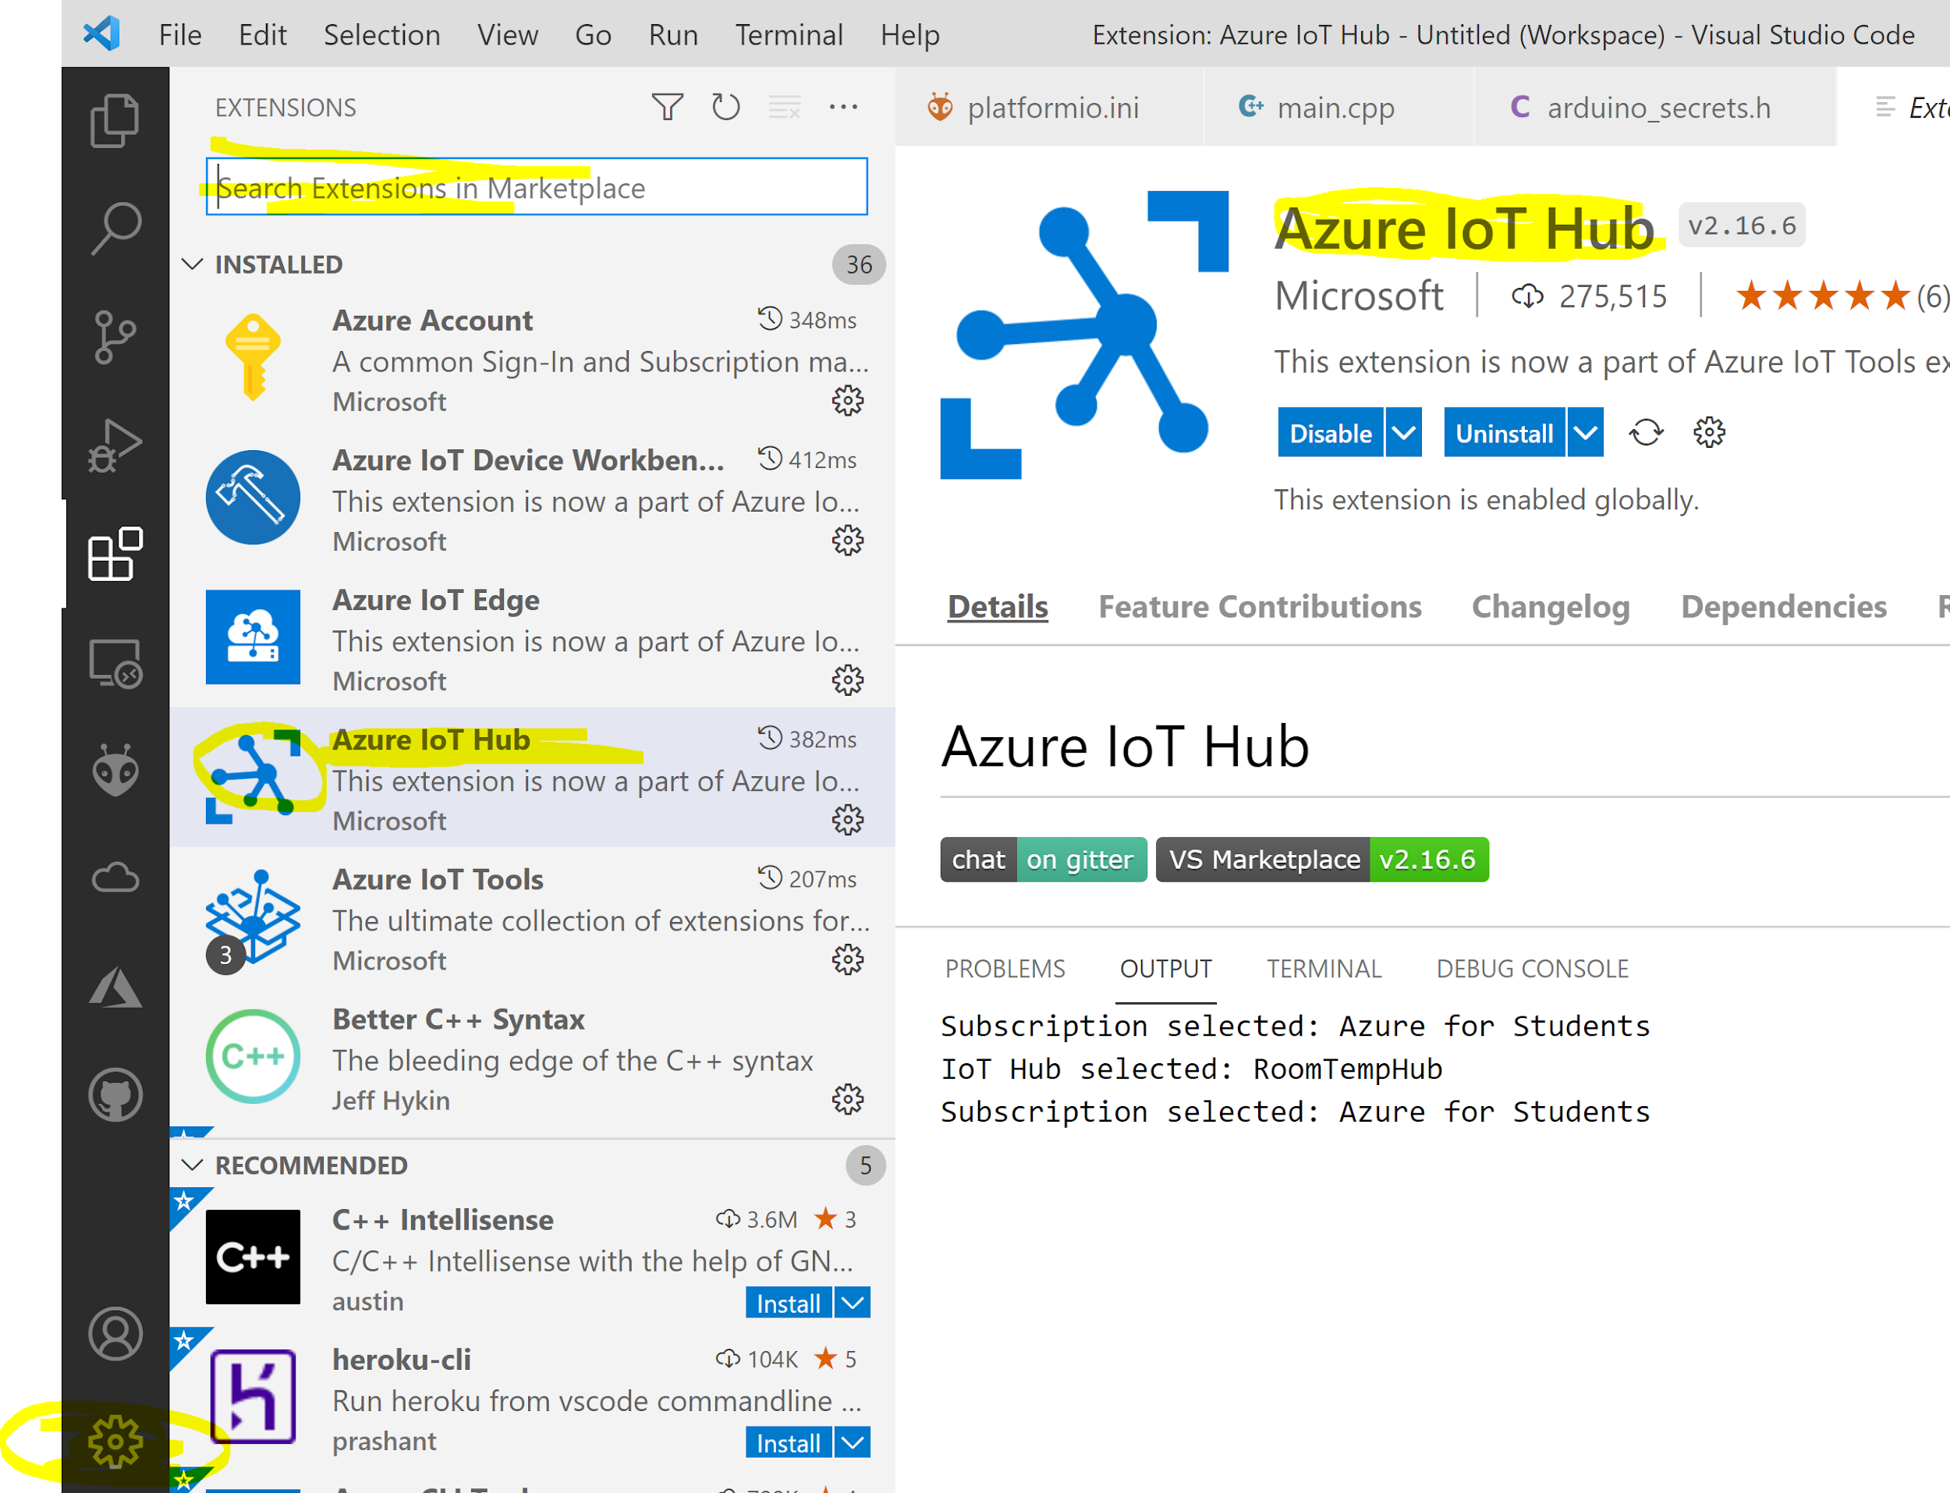
Install – Azure IoT Hub Extension
We will use this extension to generate Shared Access Signature (SAS) as Device Password
Installing Steps: Visual Studio Code / Manage / Extensions (Ctrl + Shift + X)
Once installed
Login to Azure using VS Code,
Then in the Explorer pane you’ll be able to select Azure IoT Hub,
Locate - your Hub, - the Device you created,
Right click and Generate SAS Token
Notes:
You can generate this a few ways but the easiest is to use Visual Studio Code with the Azure IoT Tools plugin. Once installed you’ll need to login to Azure using VS Code, then in the Explorer pane you’ll be able to select Azure IoT Hub, locate your Hub, the Device you created, right click and Generate SAS Token;

Slide 26
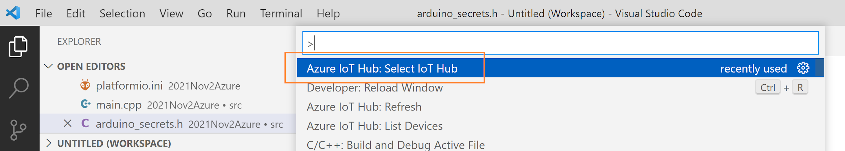
In case you cannot see the hub
Now we’ll use the device name and your hostname to build the string for SECRET_USERNAME;

Slide 27
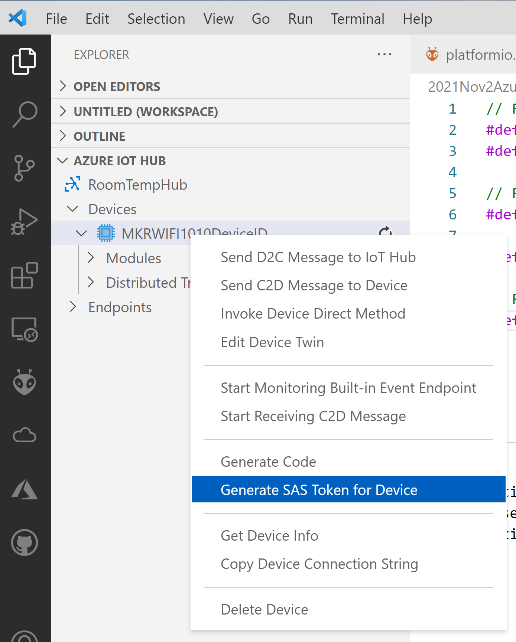
Creating the Device Password
Click on
Explorer
AZURE IOT HUB
Devices
Right Click on a device and click Generate SAS Token for Device
SAS:
Shared Access Signature
as Device Password
Notes:
Set the expiration in hours, the key is output and copied to your clipboard. You can use it exactly as it is for the SECRET_PASSWORD, just enclose it in quotes. Your code should include “SharedAccessSignature sr=”, do not omit this.

Slide 28
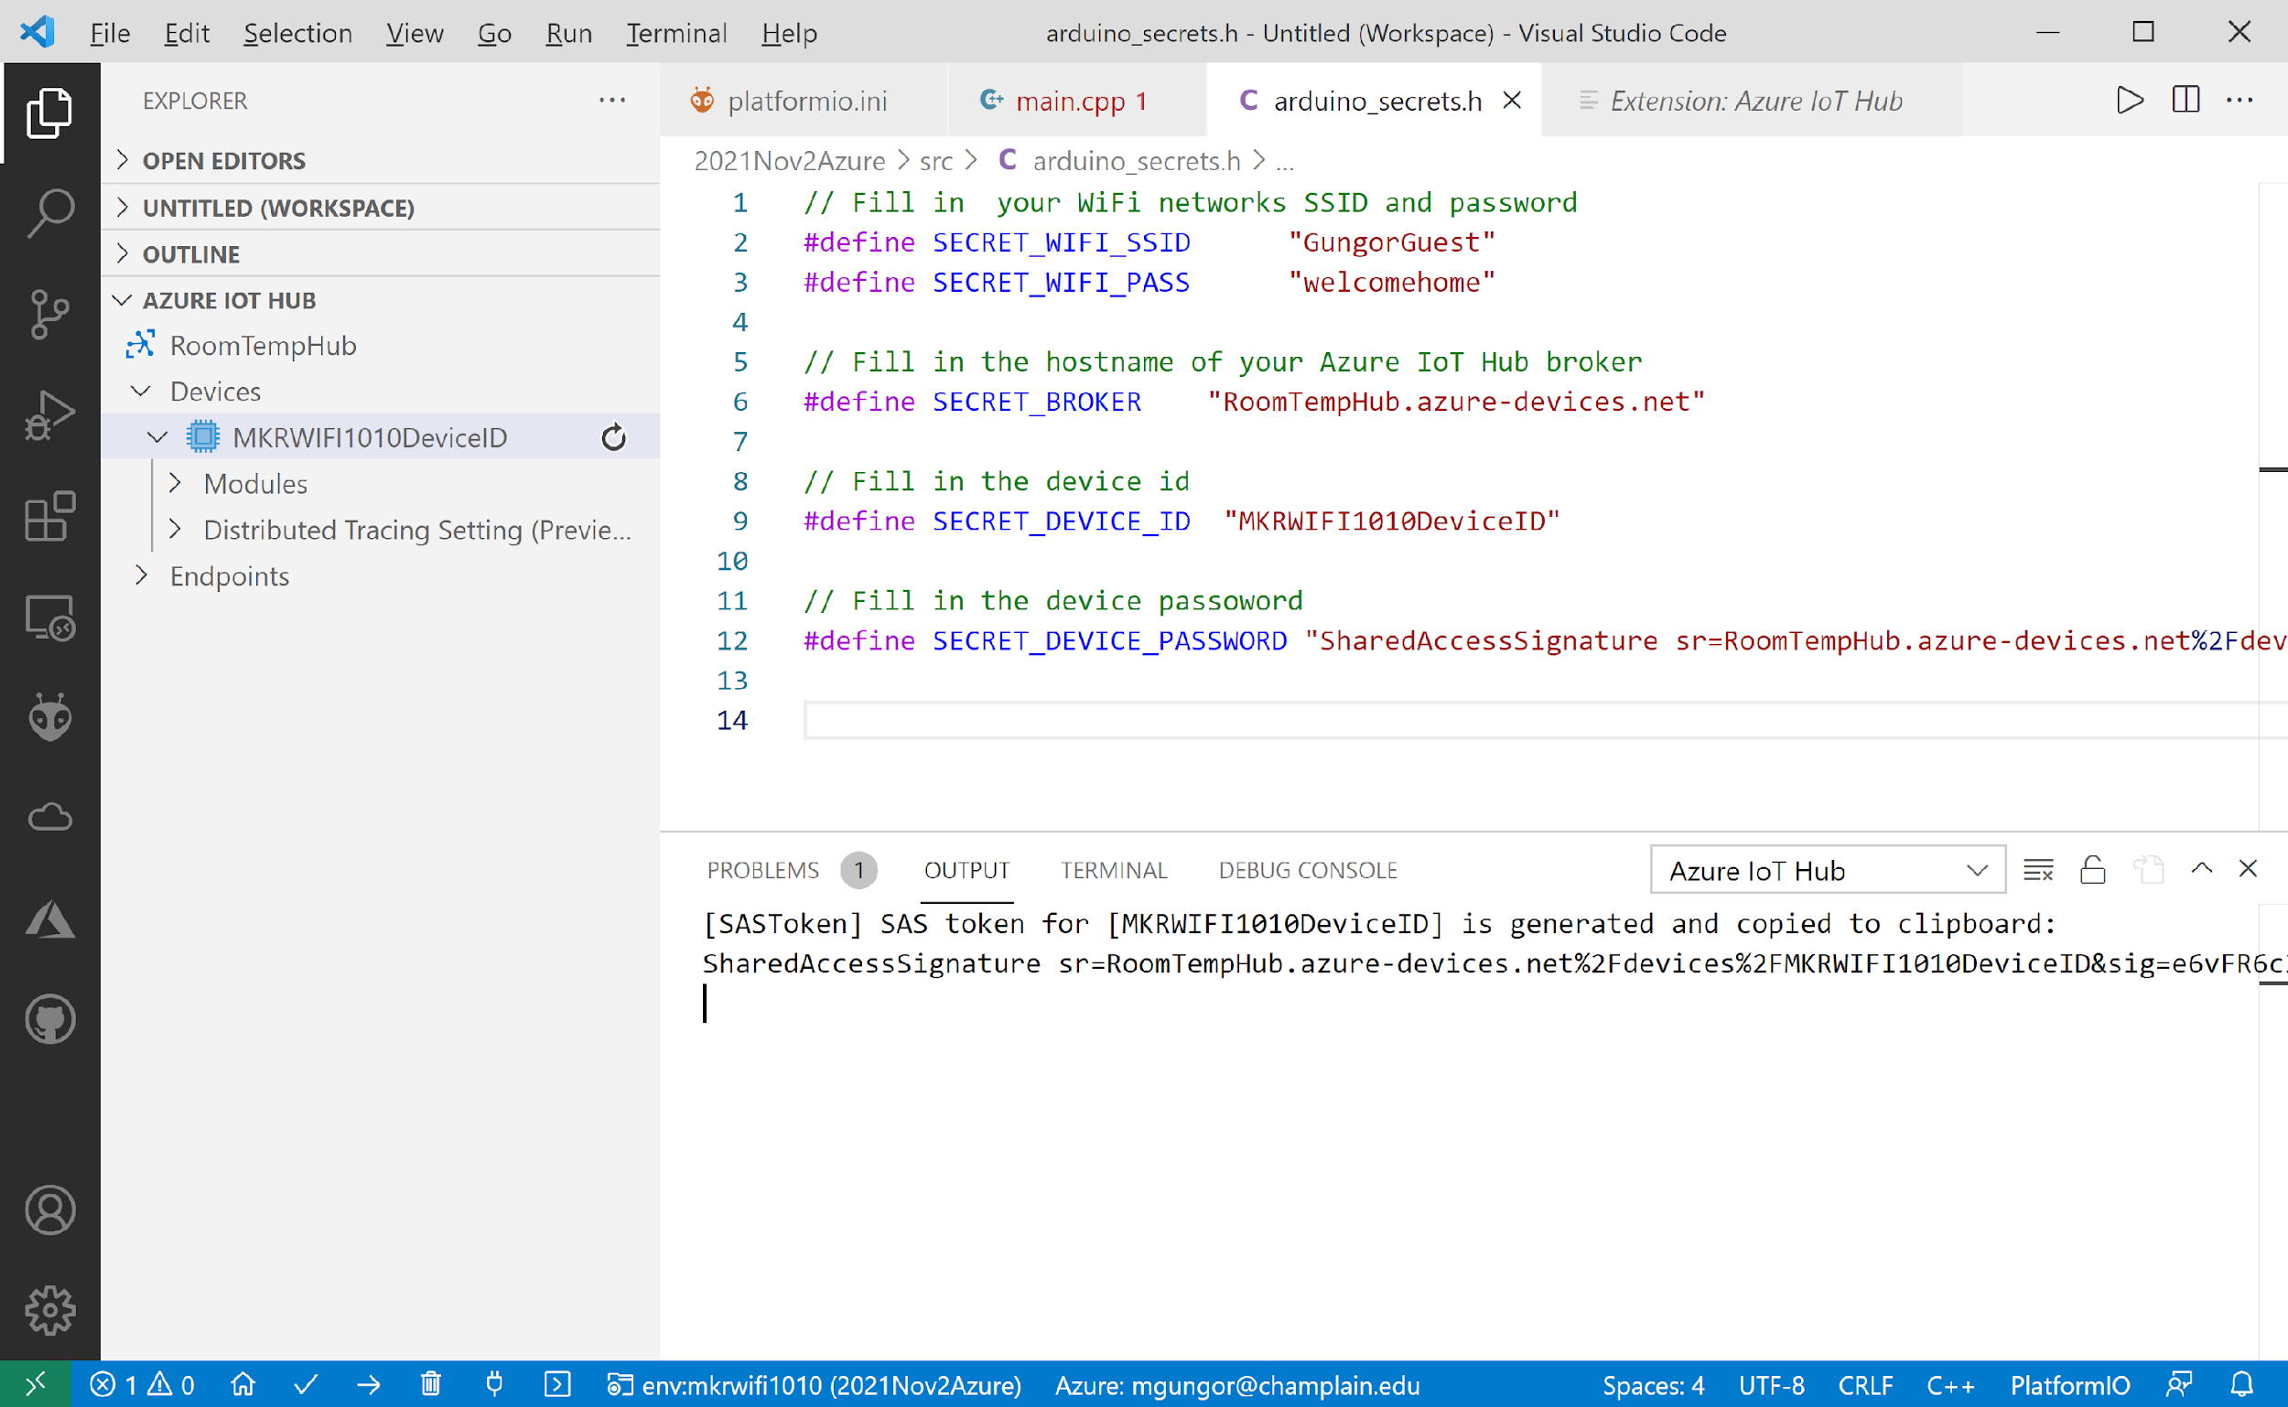
Generated SAS Token as Device Password
Set the expiration in hours, the key is output and copied to your clipboard.
You can use it exactly as it is for the SECRET_DEVICE_PASSWORD, just enclose it in quotes. Your code should include “SharedAccessSignature sr=”, do not omit this.
Notes:
Set the expiration in hours, the key is output and copied to your clipboard. You can use it exactly as it is for the SECRET_PASSWORD, just enclose it in quotes. Your code should include “SharedAccessSignature sr=”, do not omit this.

Slide 29
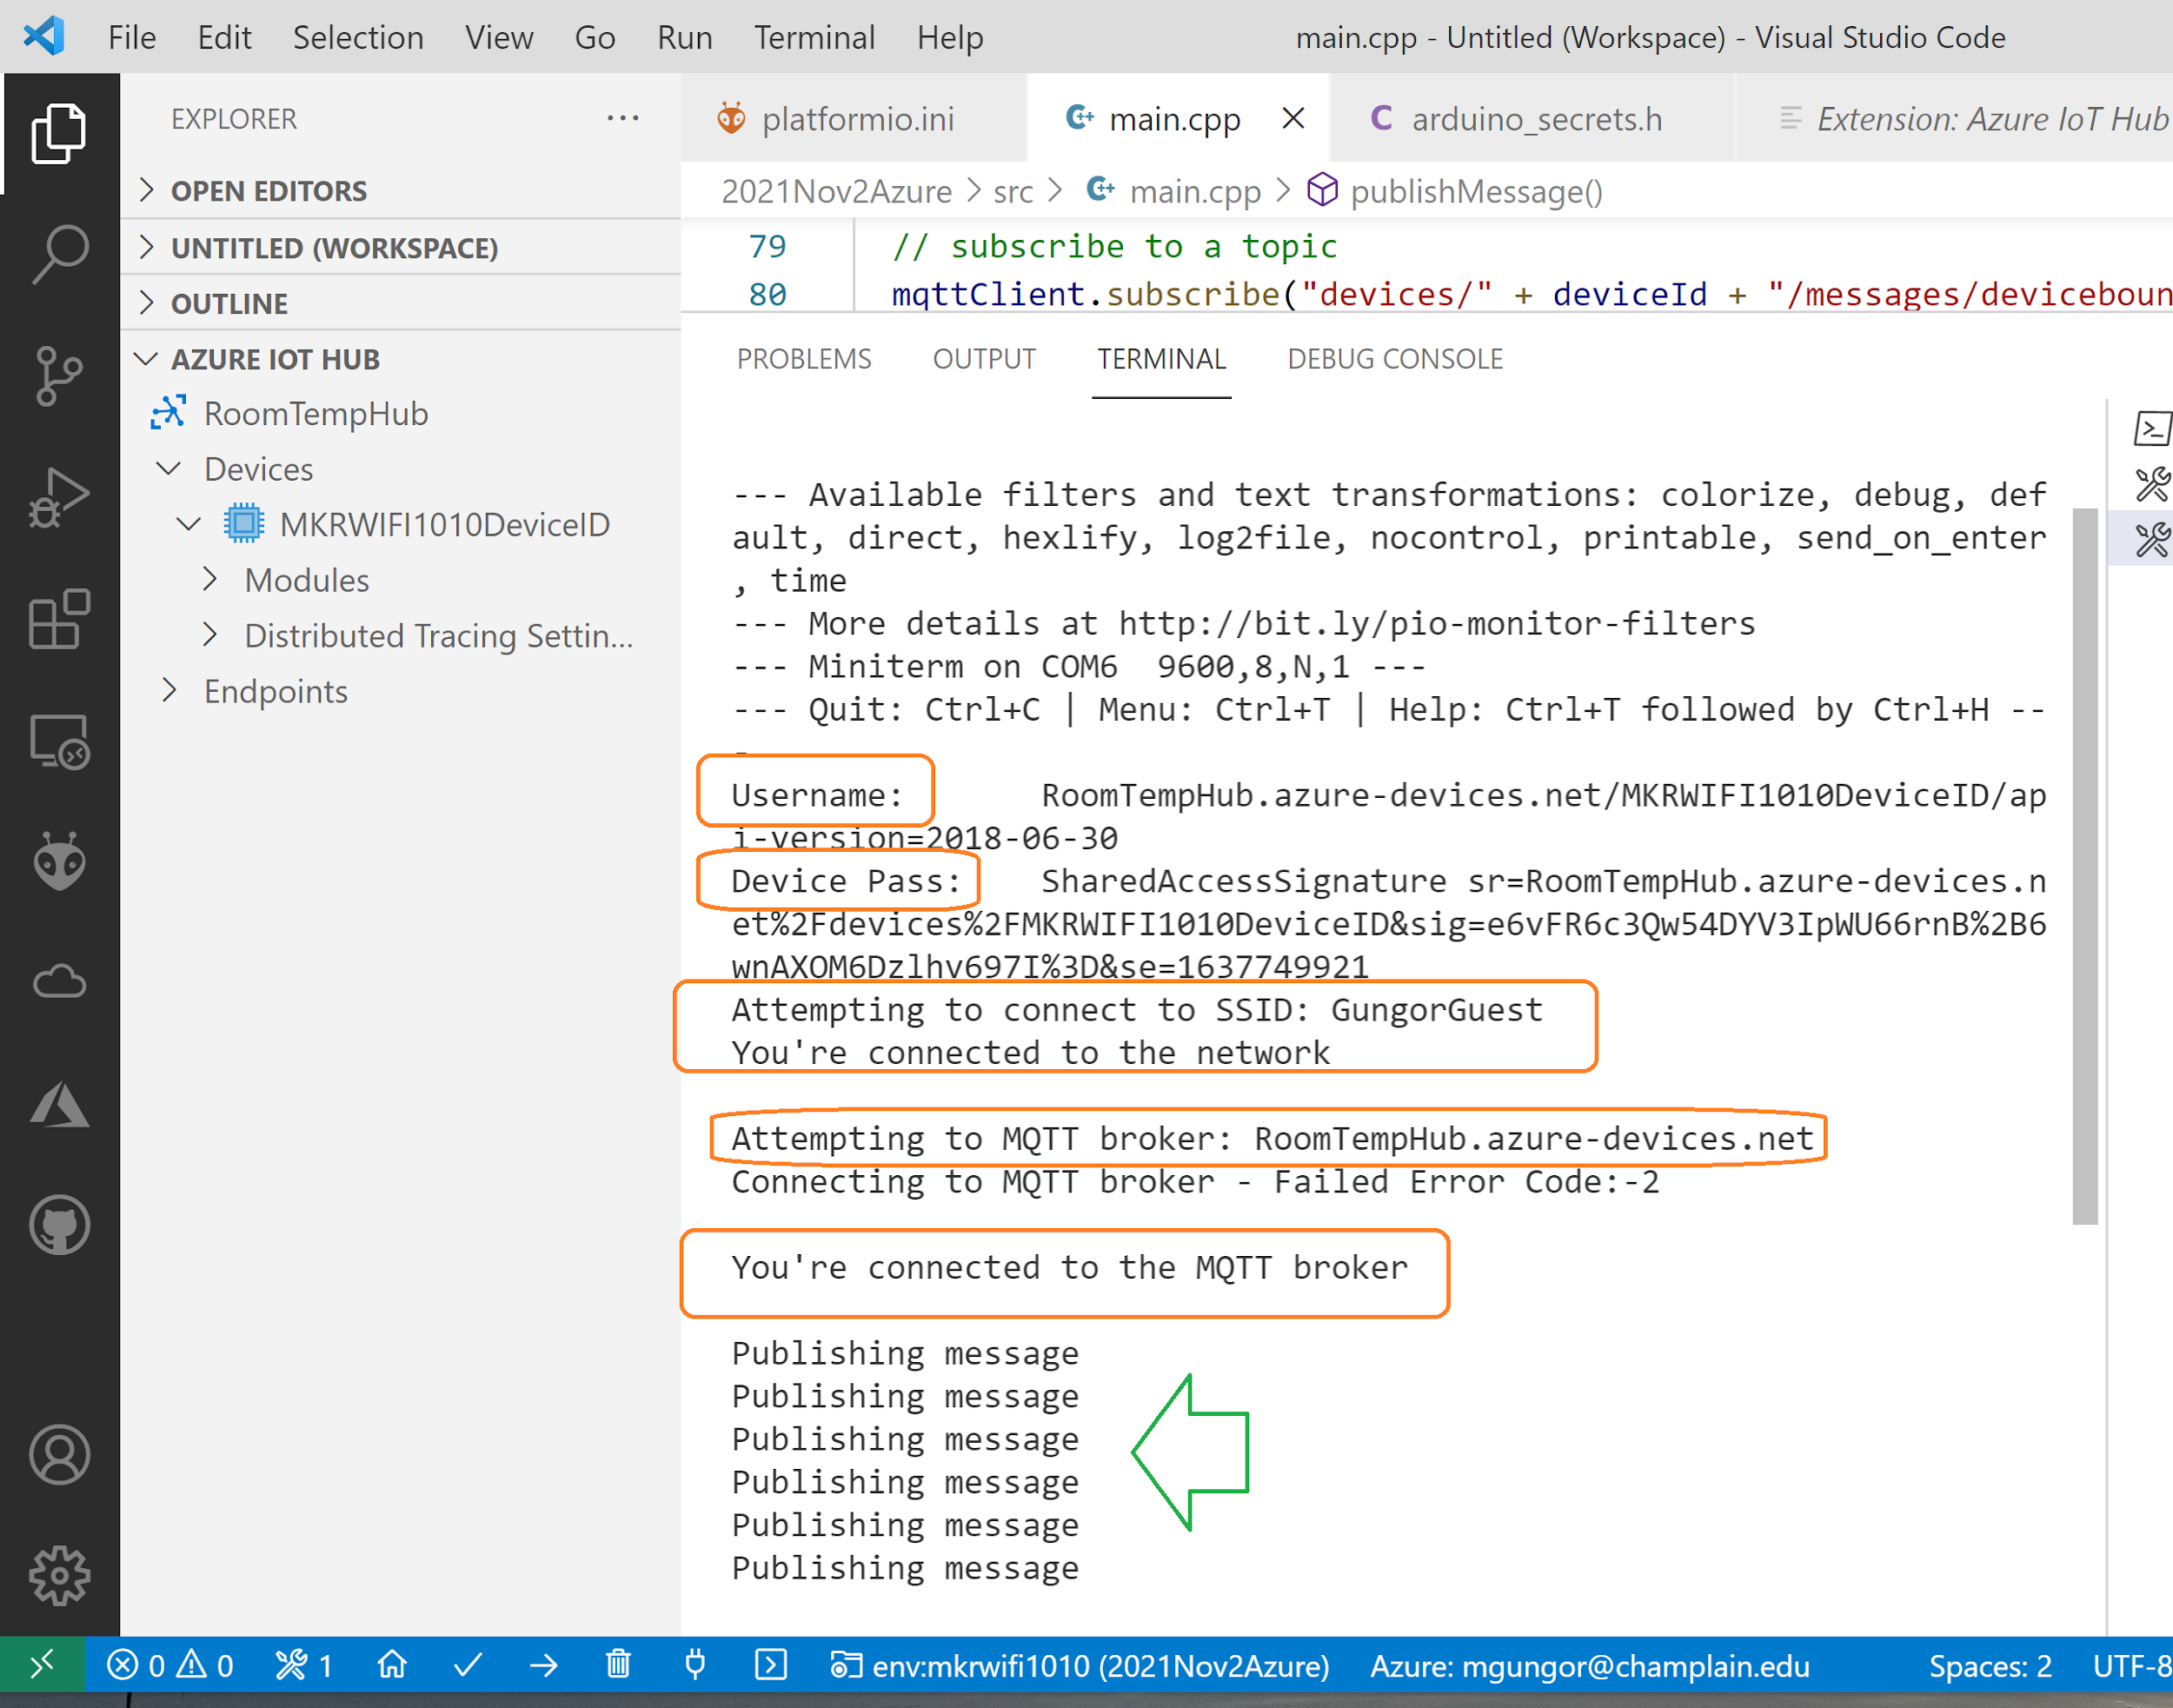
Running of the application
Possible Error Messages
#define MQTT_CONNECTION_REFUSED -2
#define MQTT_CONNECTION_TIMEOUT -1
#define MQTT_SUCCESS 0
#define MQTT_UNACCEPTABLE_PROTOCOL_VERSION 1
#define MQTT_IDENTIFIER_REJECTED 2
#define MQTT_SERVER_UNAVAILABLE 3
#define MQTT_BAD_USER_NAME_OR_PASSWORD 4
#define MQTT_NOT_AUTHORIZED 5

Slide 30

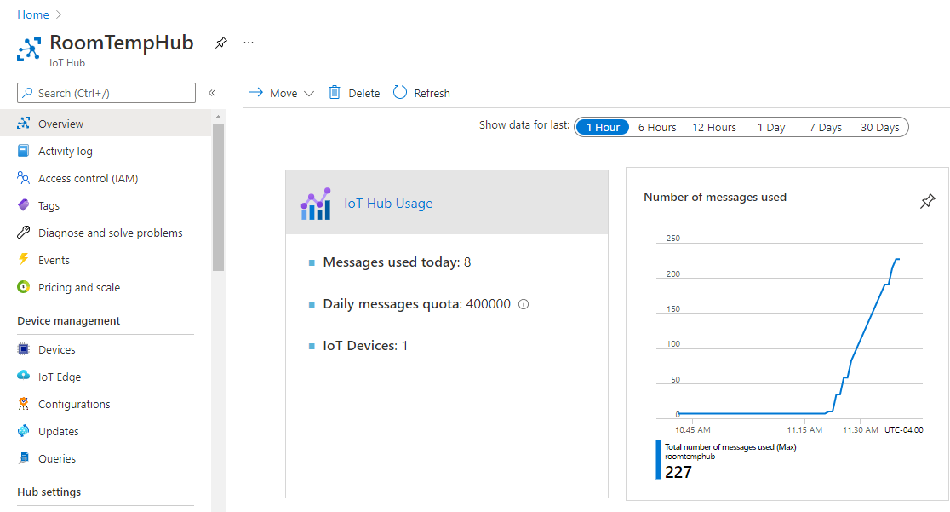
View from the IoT Hub
Yes! We are now sending some data to Azure!

Slide 31
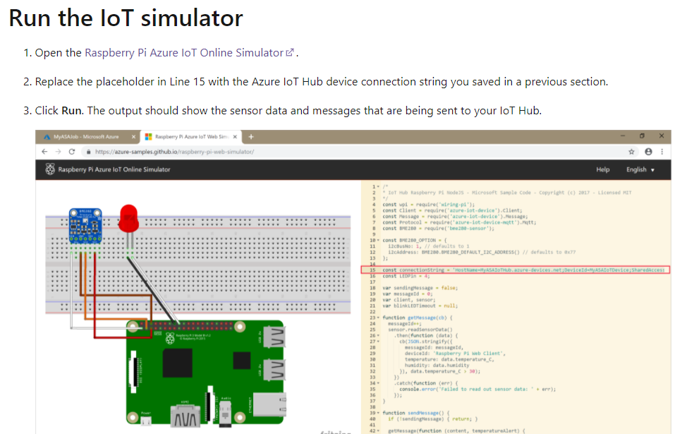
[In case]Troubleshooting: Run the IoT simulator to make sure you can connect
Link: https://docs.microsoft.com/en-us/azure/stream-analytics/stream-analytics-quick-create-portal
Open the Raspberry Pi Azure IoT Online Simulator.
Notes:
https://azure-samples.github.io/raspberry-pi-web-simulator/
Open the Raspberry Pi Azure IoT Online Simulator.

Slide 32
[Optional] Monitor Events via Azure CLI
Notes:
az login
az iot hub monitor-events --properties anno --hub-name <hub_name>
az iot hub monitor-events --properties anno --hub-name RoomTempHub
REF: https://github.com/microsoft/IoT-For-Beginners/tree/main/2-farm/lessons/4-migrate-your-plant-to-the-cloud#task---monitor-events

Slide 33
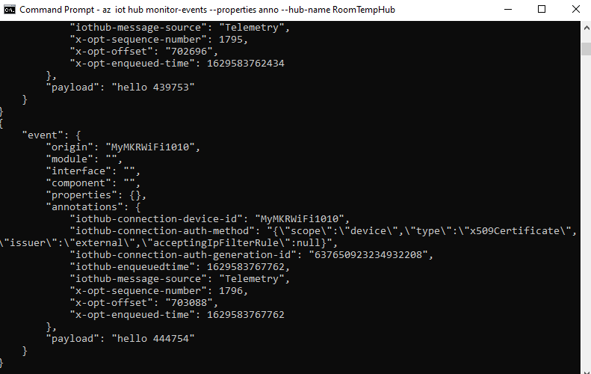
[Optional] Monitor Messages via Command Line Interface
Run the following command in your command prompt or terminal to monitor messages sent to your IoT Hub:
az iot hub monitor-events --properties anno --hub-name <hub_name>
The time values in the annotations are in UNIX time, representing the number of seconds since midnight on 1st January 1970.
Exit the event monitor when you are done.
https://www.epochconverter.com/
Notes:
az login
az iot hub monitor-events --properties anno --hub-name <hub_name>
az iot hub monitor-events --properties anno --hub-name RoomTempHub
REF: https://github.com/microsoft/IoT-For-Beginners/tree/main/2-farm/lessons/4-migrate-your-plant-to-the-cloud#task---monitor-events

Slide 34
Where are we now?

Slide 35
Arduino MKR WIFI 1010 to Azure IoT Hub
Connect a Arduino MKR WIFI 1010 board securely to Azure IoT Hub using an MQTT client. => COMPLETED
Create a consumer group on your IoT hub.
Create and configure an Azure Stream Analytics job to read temperature telemetry from your consumer group and send it to Power BI.
Create a report of the temperature data in Power BI and share it to the web.
https://docs.microsoft.com/en-us/azure/iot-hub/iot-hub-live-data-visualization-in-power-bi
Notes:
Used mainly these steps
https://docs.microsoft.com/en-us/azure/iot-hub/iot-hub-live-data-visualization-in-power-bi
https://docs.microsoft.com/en-us/azure/stream-analytics/stream-analytics-quick-create-portal
https://docs.microsoft.com/en-us/azure/iot-hub/iot-hub-raspberry-pi-web-simulator-get-started
This tutorial will walk you through how to connect a Arduino MKR WIFI 1010 board securely to Azure IoT Hub using an MQTT client.
Create a consumer group on your IoT hub.
Create and configure an Azure Stream Analytics job to read temperature telemetry from your consumer group and send it to Power BI.
Create a report of the temperature data in Power BI and share it to the web.
MQTT (Message Queuing Telemetry Transport) is a M2M (machine-to-machine) connectivity protocol which provides a messaging subscription and publish transport.

Slide 36
Visualize real-time sensor data from Azure IoT Hub
Reference
https://docs.microsoft.com/en-us/azure/iot-hub/iot-hub-live-data-visualization-in-power-bi
Notes:
Tutorial: Visualize real-time sensor data from Azure IoT Hub using Power BI
https://docs.microsoft.com/en-us/azure/iot-hub/iot-hub-live-data-visualization-in-power-bi
https://docs.microsoft.com/en-us/azure/data-explorer/ingest-data-iot-hub
How to Capture IoT Data in Azure
Updated: 2020-02-27
https://www.mssqltips.com/sqlservertip/6335/how-to-capture-iot-data-in-azure/

Slide 37
Coding Part 2 Sending temperature and humidity telemetry

Slide 38
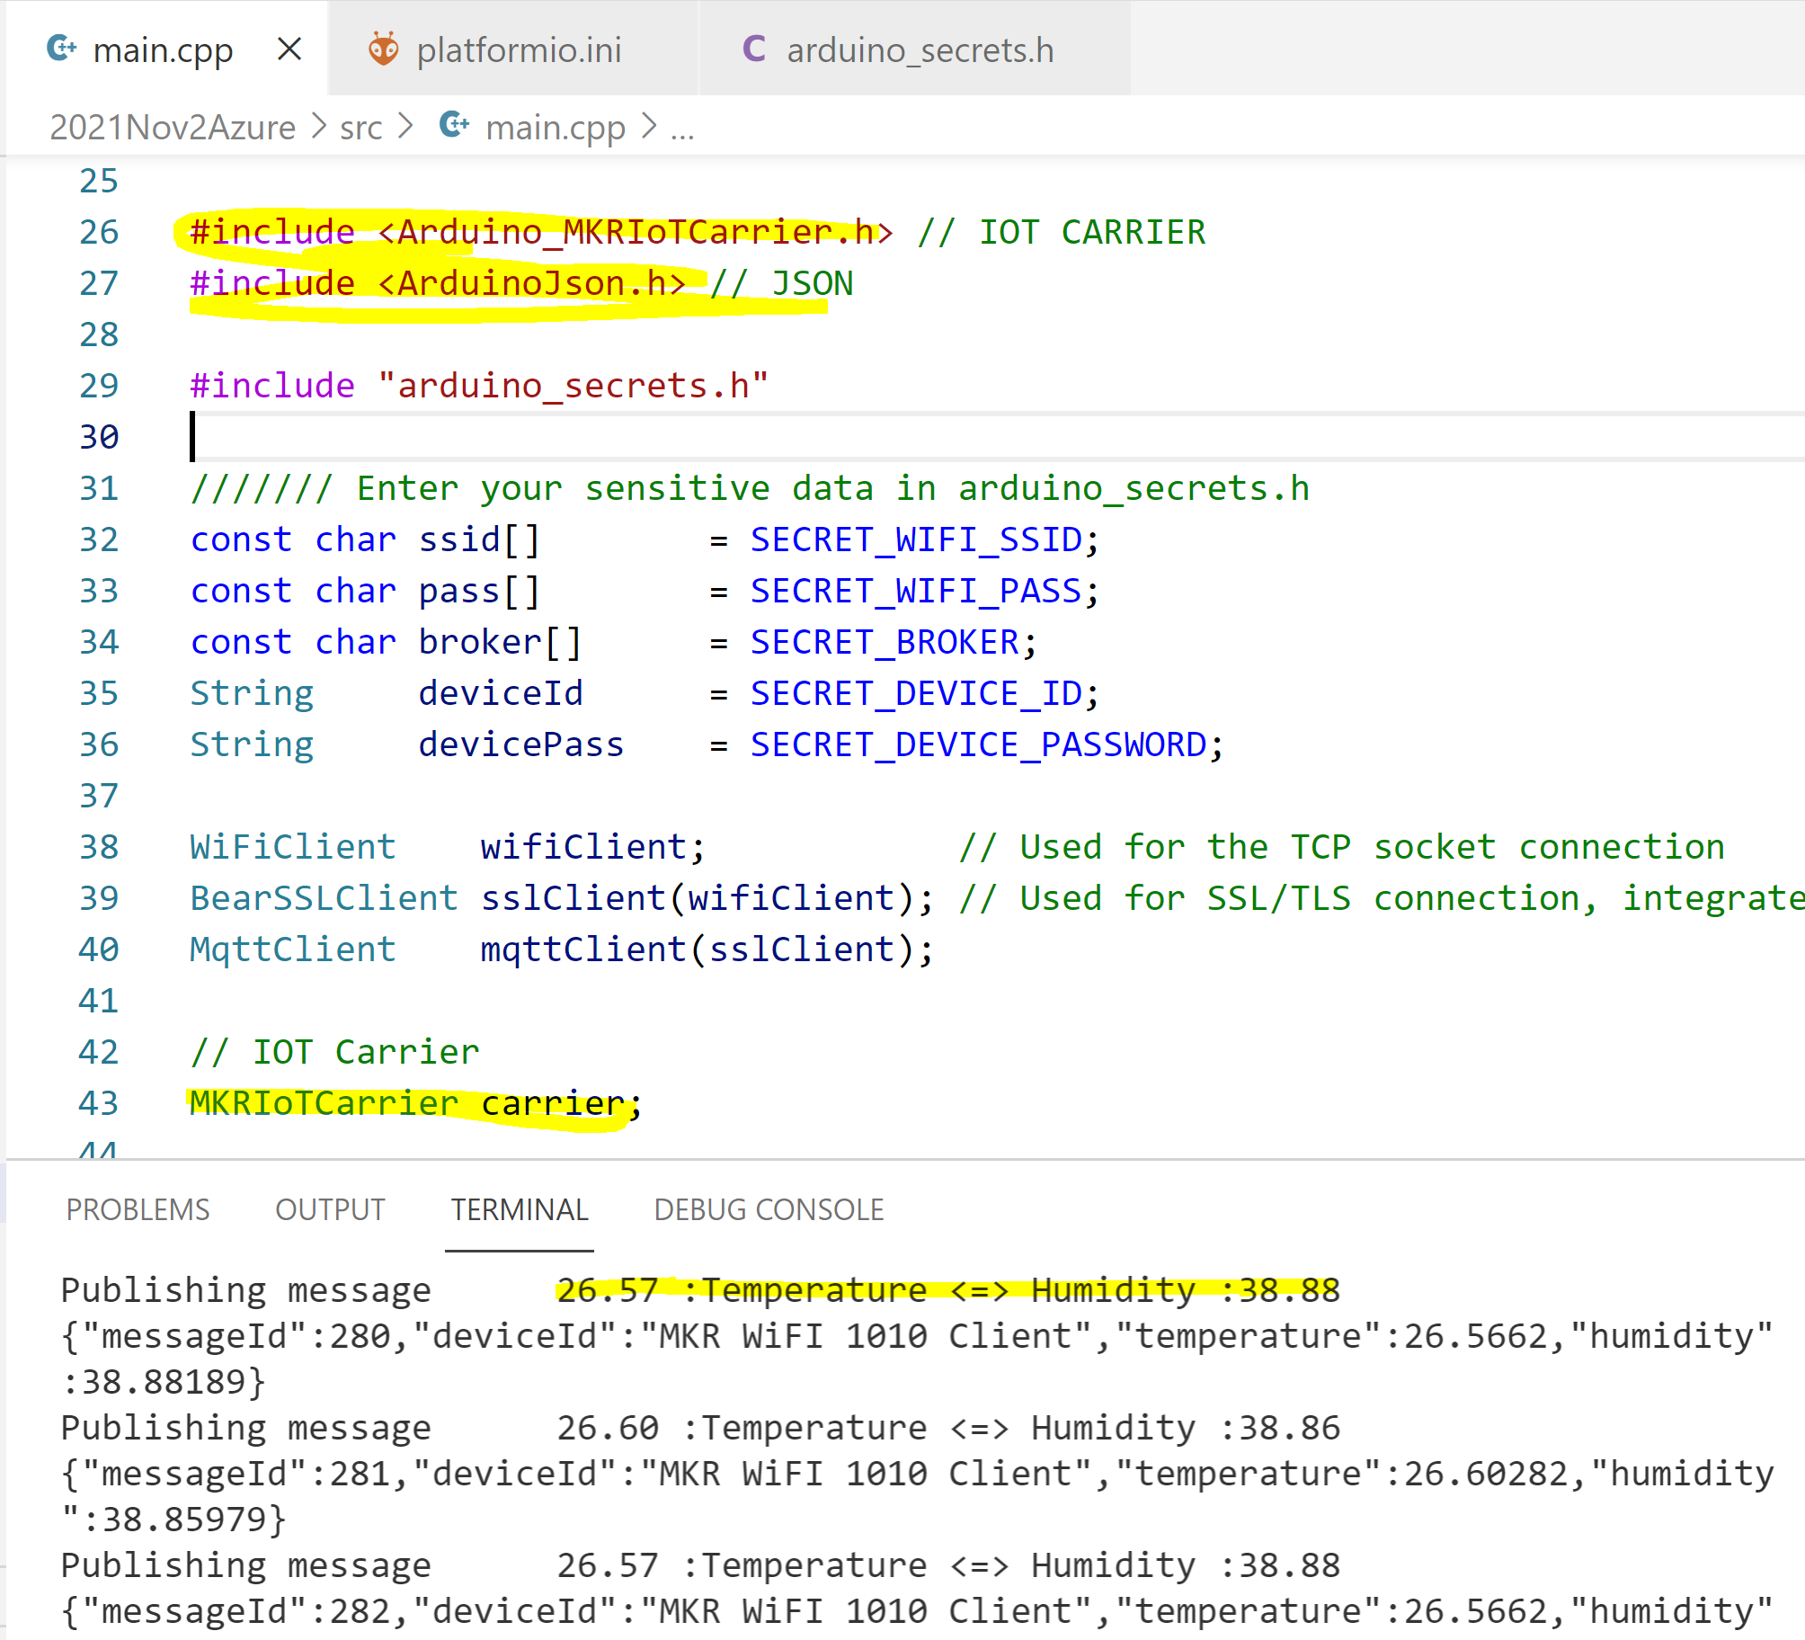



Coding Side – Sending Telemetry Data
This time we are using JSON format to send telemetry messages.
publishTemperatureHumidity() function added
IoT Carrier code changes added.

Slide 39
Forming JSON Message to Send
void publishTemperatureHumidity() {
Serial.print("Publishing message\t");
// Read Sensor Data
float temperature = carrier.Env.readTemperature();
float humidity = carrier.Env.readHumidity(); … DynamicJsonDocument doc(1024);
doc["messageId"] = meesageId++;
doc["deviceId"] = "MKR WiFI 1010 Client";
doc["temperature"] = temperature;
doc["humidity"] = humidity;
string telemetry;
serializeJson(doc, telemetry);
Serial.println(telemetry.c_str());
// send message, the Print interface can be used to set the message contents
mqttClient.beginMessage("devices/" + deviceId + "/messages/events/");
mqttClient.print(telemetry.c_str());
mqttClient.endMessage();
}
Reading telemetry from sensors
Forming JSON payload
Sending the message

Slide 40
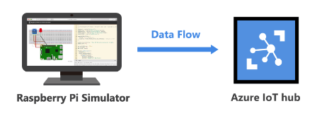
QuickStart: Create a Stream Analytics job by using the Azure portal
Notes:
https://docs.microsoft.com/en-us/azure/stream-analytics/stream-analytics-quick-create-portal
https://docs.microsoft.com/en-us/azure/iot-hub/iot-hub-raspberry-pi-web-simulator-get-started

Slide 41
What Is Azure Stream Analytics?
https://www.youtube.com/watch?v=po-R-XsSZnM
Notes:
https://www.youtube.com/watch?v=po-R-XsSZnM

Slide 42
Visualize real-time sensor data
To visualize real-time sensor data that your Azure IoT hub receives.
To do so, you configure an Azure Stream Analytics job to consume the data from IoT Hub
and route it to a dataset in Power BI.
https://docs.microsoft.com/en-us/azure/iot-hub/iot-hub-live-data-visualization-in-power-bi
Notes:
https://docs.microsoft.com/en-us/azure/iot-hub/iot-hub-live-data-visualization-in-power-bi

Slide 43
Add a consumer group to your IoT hub
To add a consumer group to your IoT hub, follow these steps:
In the Azure portal, open your IoT hub.
On the left pane, select Built-in endpoints. Enter a name for your new consumer group in the text box under Consumer groups.
Click anywhere outside the text box to save the consumer group.
Notes:
https://docs.microsoft.com/en-us/azure/iot-hub/iot-hub-live-data-visualization-in-power-bi#add-a-consumer-group-to-your-iot-hub
Consumer groups provide independent views into the event stream that enable apps and Azure services to independently consume data from the same Event Hub endpoint. In this section, you add a consumer group to your IoT hub's built-in endpoint that is used later in this tutorial to pull data from the endpoint.
To add a consumer group to your IoT hub, follow these steps:
In the Azure portal, open your IoT hub.
On the left pane, select Built-in endpoints. Enter a name for your new consumer group in the text box under Consumer groups.

Slide 44
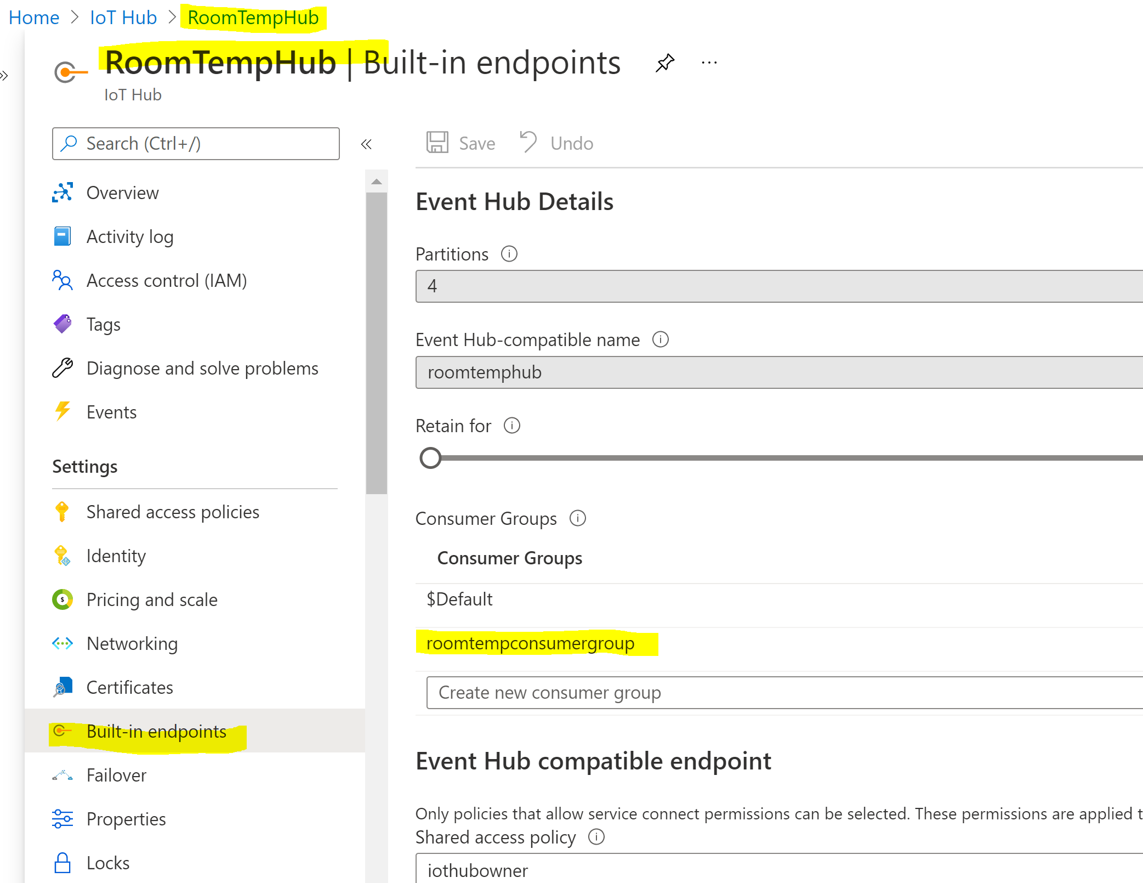
Create a new Consumer Group
Notes:
roomtempconsumergroup

Slide 45
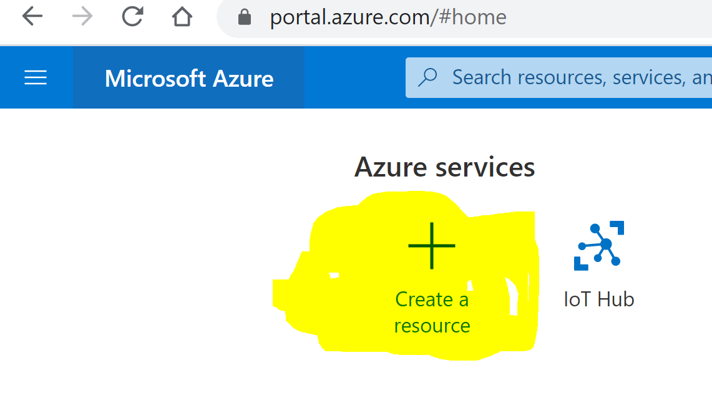
Create, configure, and run a Stream Analytics job
In the Azure portal, select Create a resource. Type Stream Analytics Job in the search box and select it from the drop-down list. On the Stream Analytics job overview page, select Create
Notes:
https://docs.microsoft.com/en-us/azure/iot-hub/iot-hub-live-data-visualization-in-power-bi#create-configure-and-run-a-stream-analytics-job

Slide 46
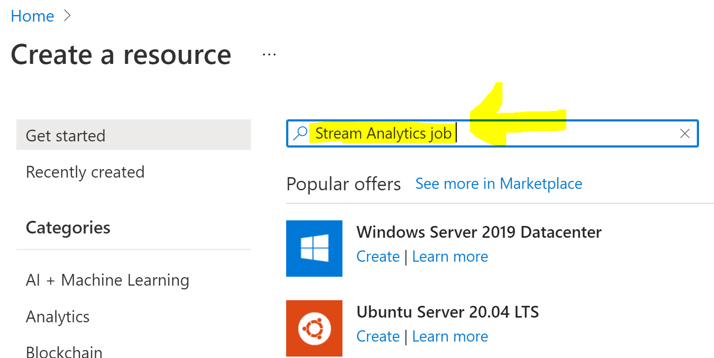
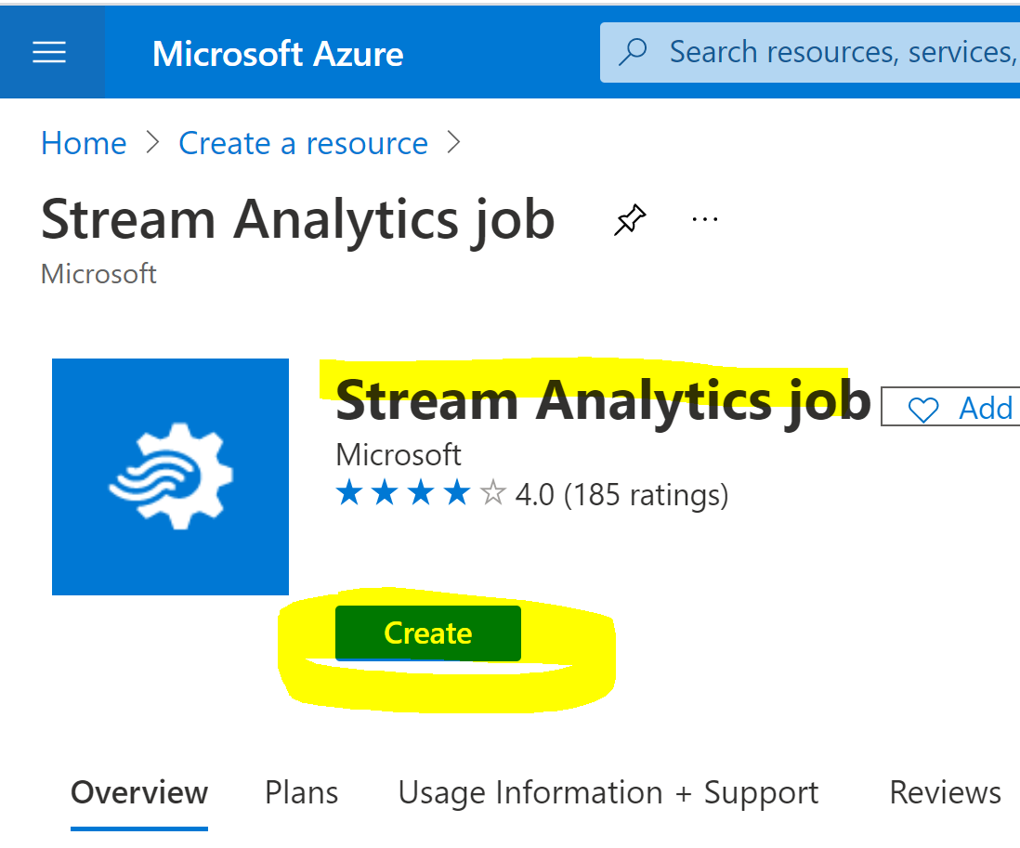
Search: Stream Analytics job

Slide 47
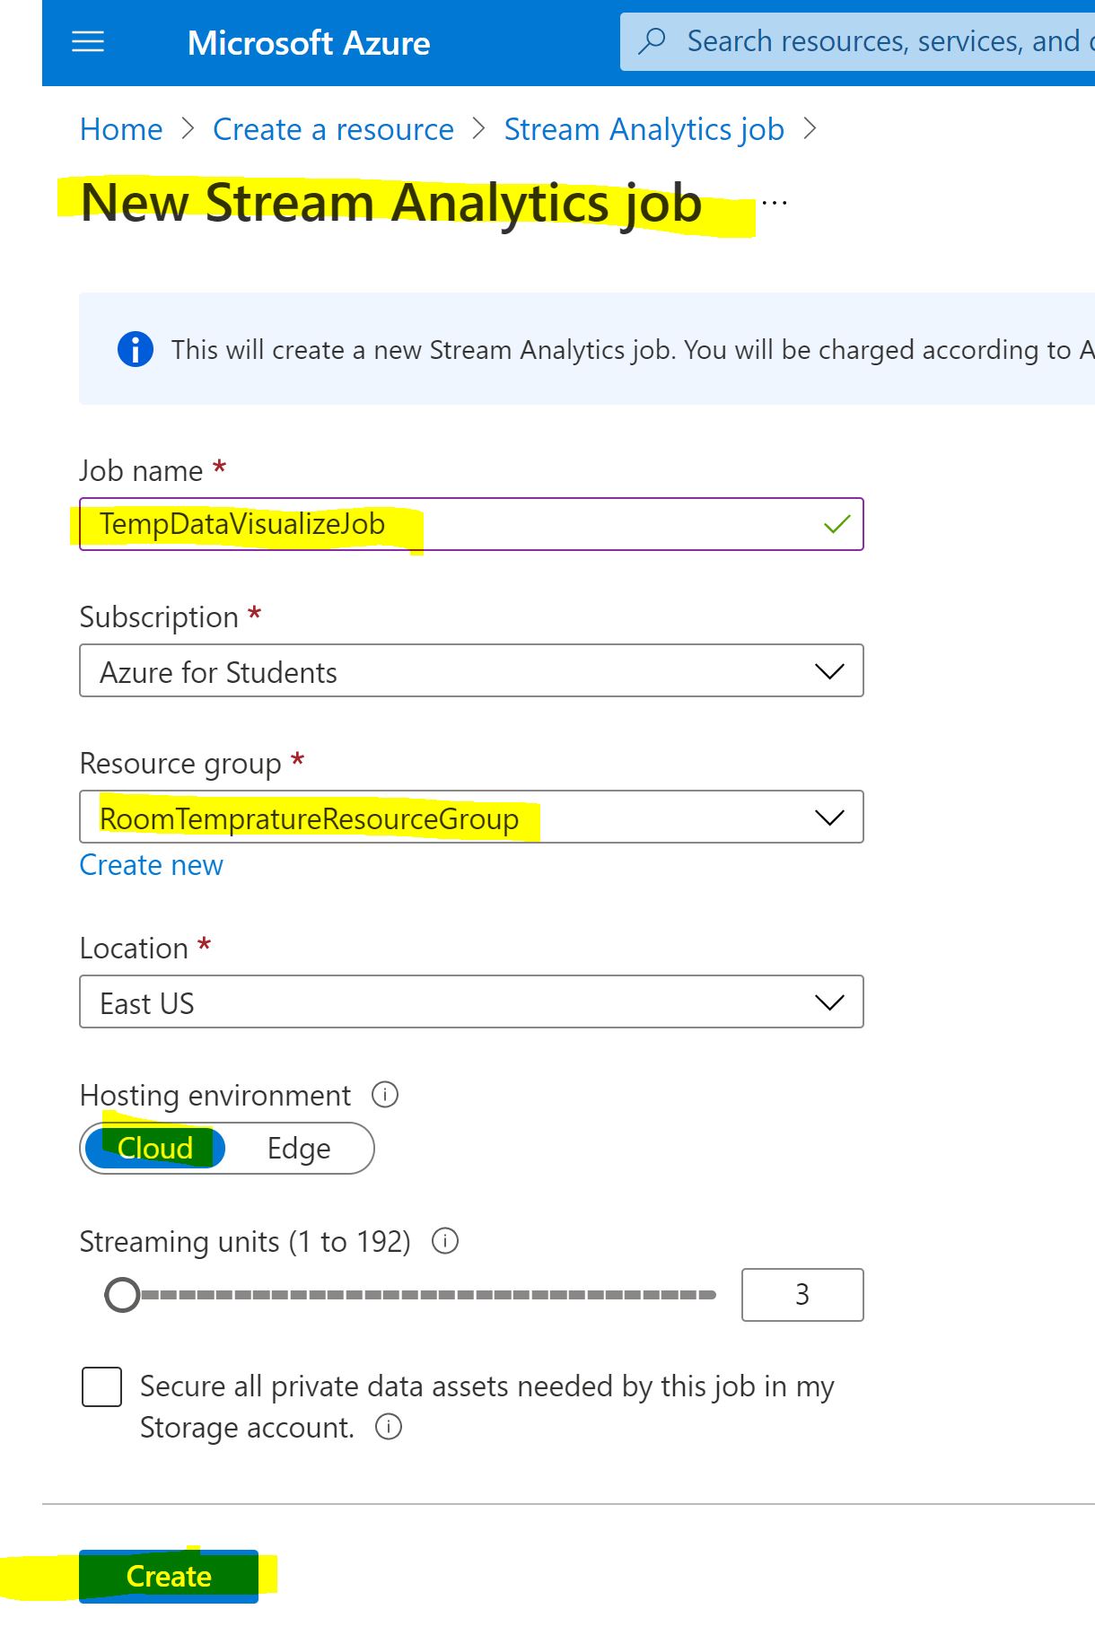
Next
Be Patient
Deployment is in progress

Slide 48
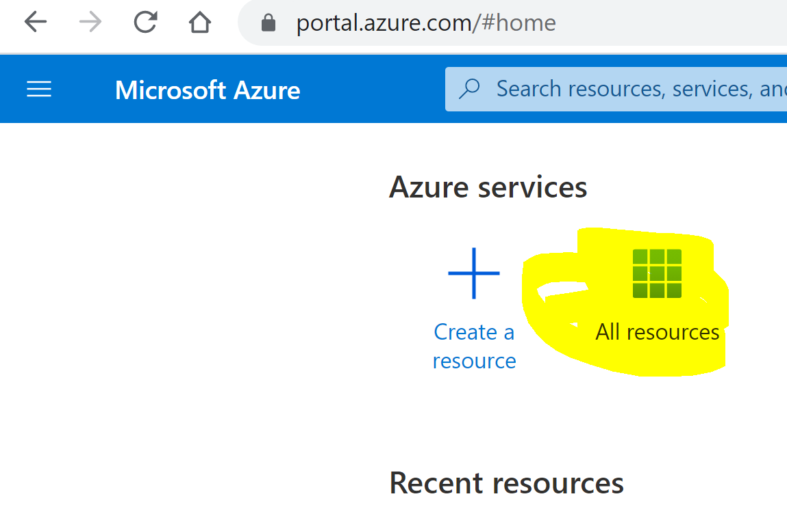
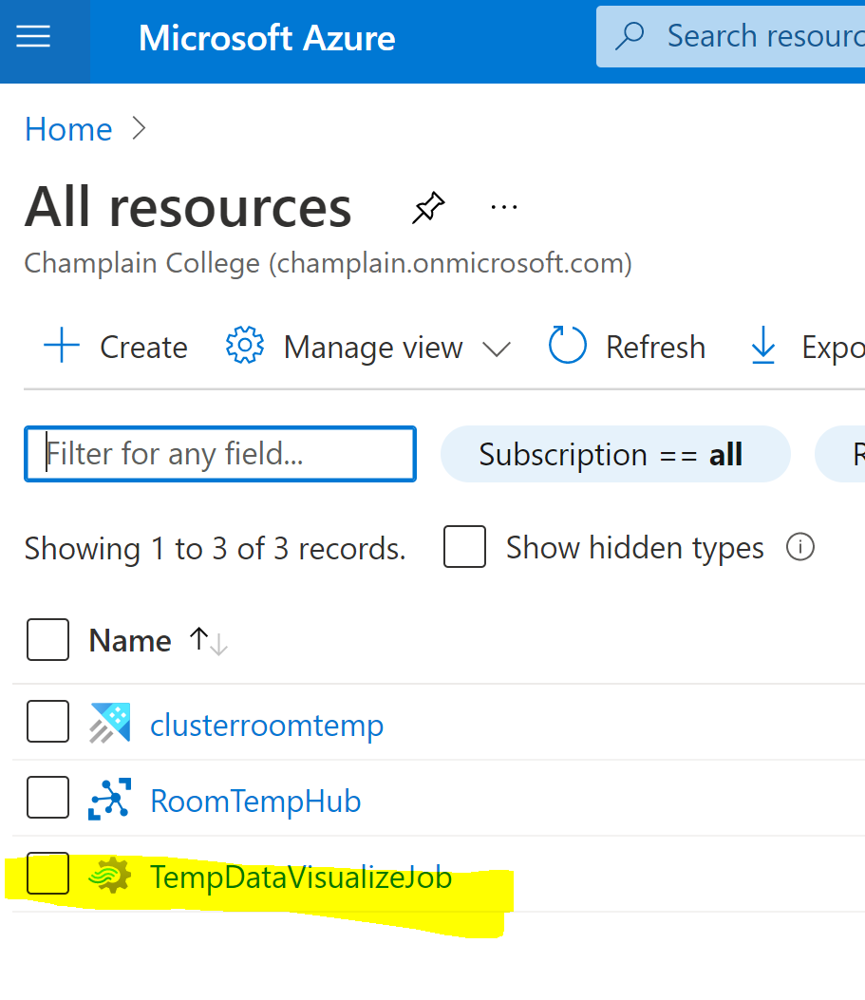
Done! Check it out: You have now the Stream Analytics job
Notes:
https://docs.microsoft.com/en-us/azure/iot-hub/iot-hub-live-data-visualization-in-power-bi#add-an-input-to-the-stream-analytics-job

Slide 49
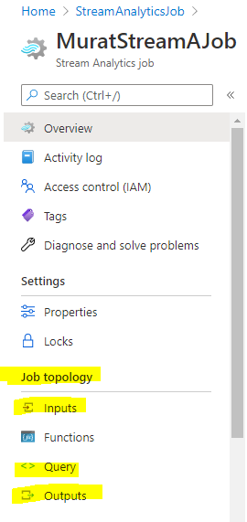
Add Stream Input & Add Stream Output Add Query

Slide 50
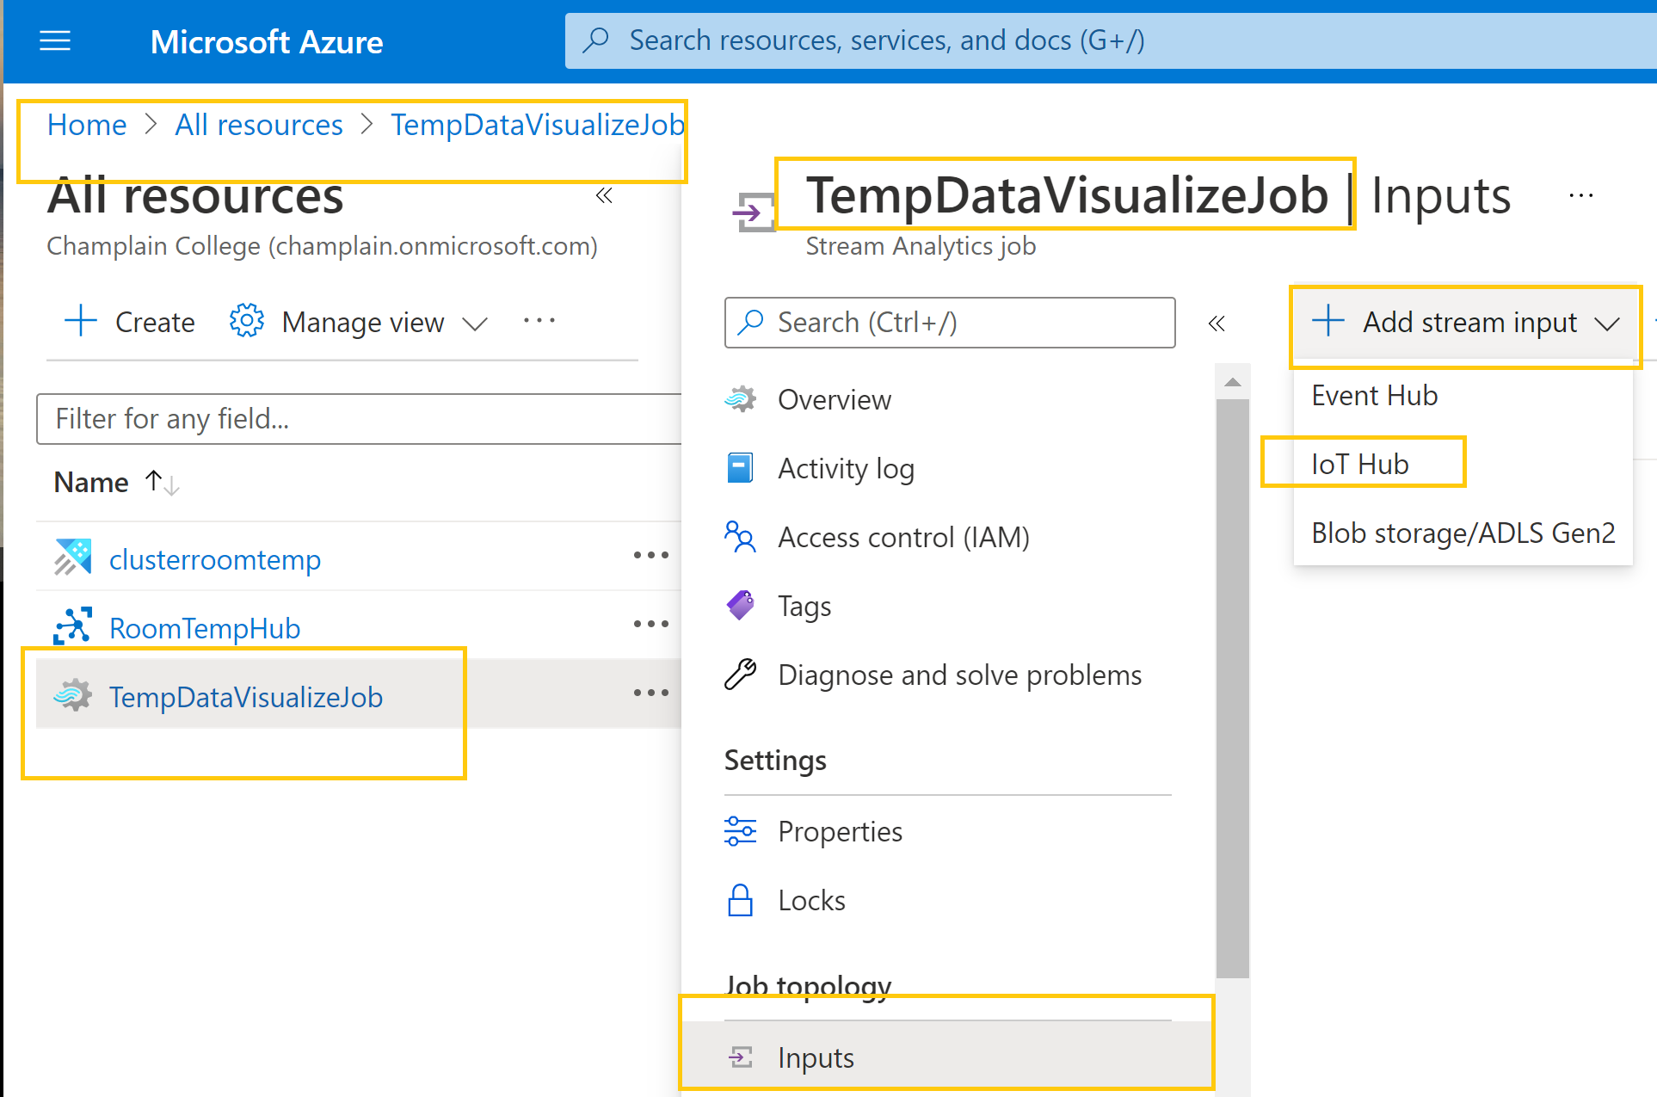
Select Add stream input, then select IoT Hub from the drop-down list
Open the Stream Analytics job.
Under Job topology, select Inputs.
1
https://docs.microsoft.com/en-us/azure/iot-hub/iot-hub-live-data-visualization-in-power-bi#add-an-input-to-the-stream-analytics-job
Notes:
https://docs.microsoft.com/en-us/azure/iot-hub/iot-hub-live-data-visualization-in-power-bi#add-an-input-to-the-stream-analytics-job

Slide 51
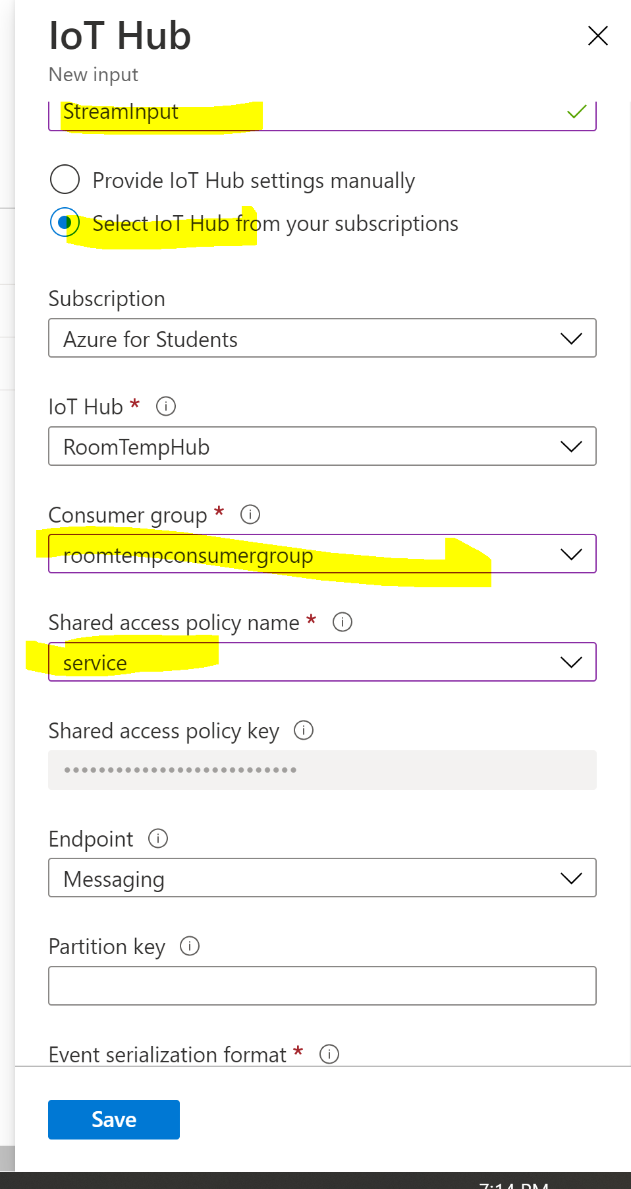
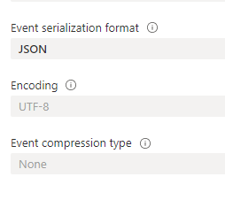
Add Stream Input
Remember input stream name
We will need it when we are setting up input query
Our code updated to send telemetry as JSON format
2
Notes:
Input alias: Enter a unique alias for the input.
Select IoT Hub from your subscription: Select this radio button.
Subscription: Select the Azure subscription you're using for this tutorial.
IoT Hub: Select the IoT Hub you're using for this tutorial.
Endpoint: Select Messaging.
Shared access policy name: Select the name of the shared access policy you want the Stream Analytics job to use for your IoT hub. For this tutorial, you can select service. The service policy is created by default on new IoT hubs and grants permission to send and receive on cloud-side endpoints exposed by the IoT hub. To learn more, see Access control and permissions.
Shared access policy key: This field is autofilled based on your selection for the shared access policy name.
Consumer group: Select the consumer group you created previously.
Leave all other fields at their defaults.

Slide 52
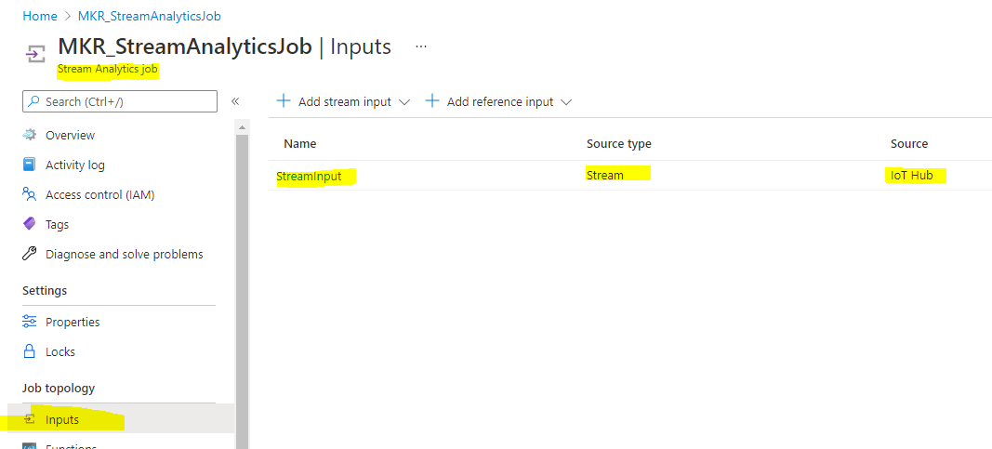
Done! Stream Input Added
Remember input stream name
We will need it when we are setting up input query
3

Slide 53
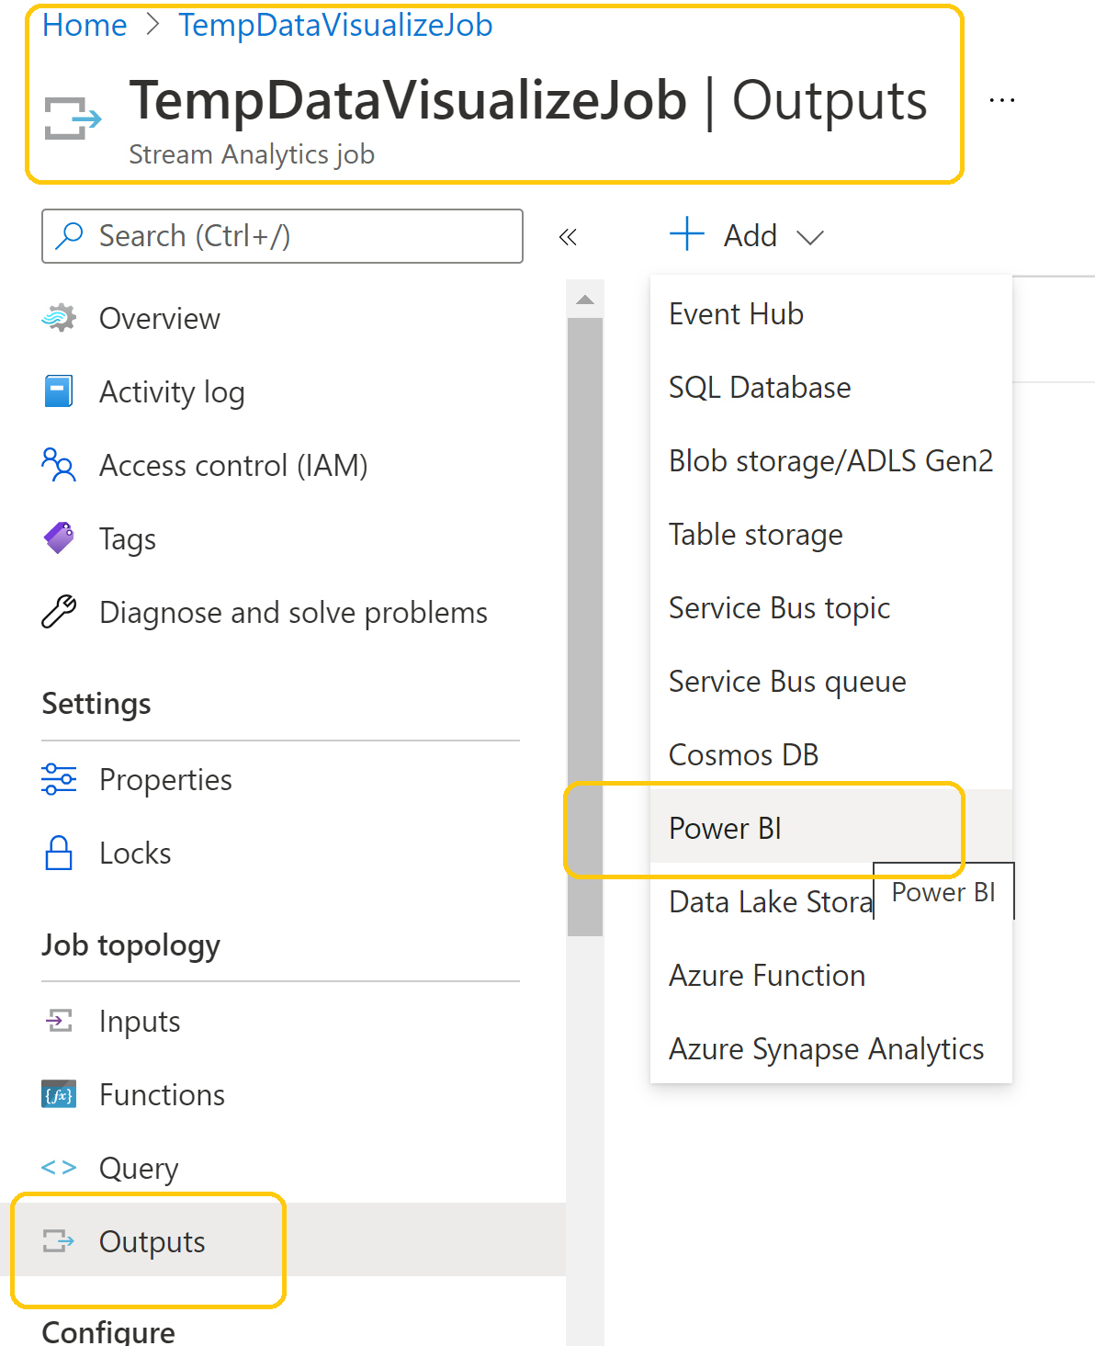
Add a Stream Output to the Stream Analytics job
Under Job topology, select Outputs.
In the Outputs pane, select Add, and then select Power BI from the drop-down list.
On the Power BI – New output pane, select Authorize and follow the prompts to sign in to your Power BI account.
4

Slide 54
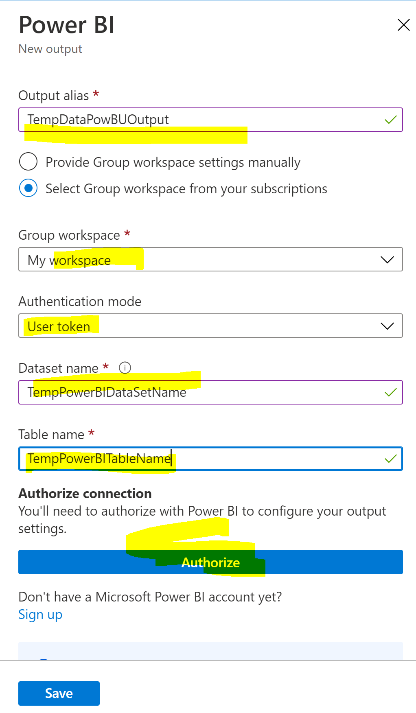
Add a Stream Output
Remember output stream name
We will need it when we are setting up input query
After you've signed in to Power BI, enter the following information:
Output alias: A unique alias for the output.
Group workspace: Select your target group workspace.
Dataset name: Enter a dataset name.
Table name: Enter a table name.
Authentication mode: Leave at the default.
5

Slide 55
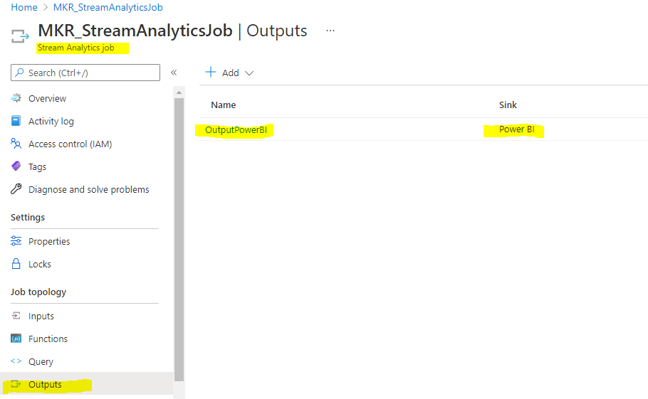
Done! Stream Output Added
Remember output stream name
We will need it when we are setting up input query
6

Slide 56
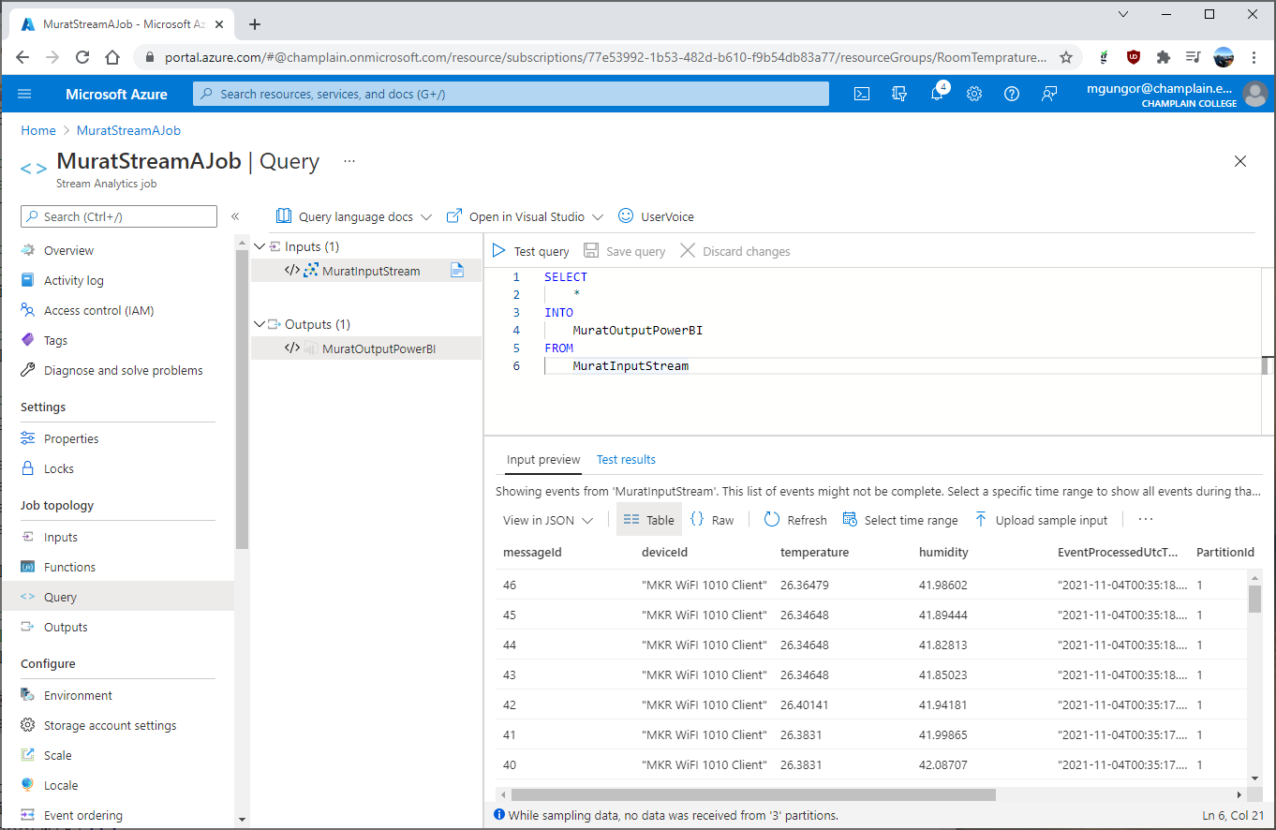
Query – FROM and INTO update
Test Query
Under Job topology, select Query.
Replace [YourInputAlias]
with the input alias of the job.
Replace [YourOutputAlias]
with the output alias of the job.
Observe the input
7
https://docs.microsoft.com/en-us/azure/iot-hub/iot-hub-live-data-visualization-in-power-bi#configure-the-query-of-the-stream-analytics-job
Notes:
https://docs.microsoft.com/en-us/azure/iot-hub/iot-hub-live-data-visualization-in-power-bi#configure-the-query-of-the-stream-analytics-job
Configure the query of the Stream Analytics job
Under Job topology, select Query.
Replace [YourInputAlias] with the input alias of the job.
Replace [YourOutputAlias] with the output alias of the job.
Add the following WHERE clause as the last line of the query. This line ensures that only messages with a temperature property will be forwarded to Power BI.
SQL
WHERE temperature IS NOT NULL

Slide 57
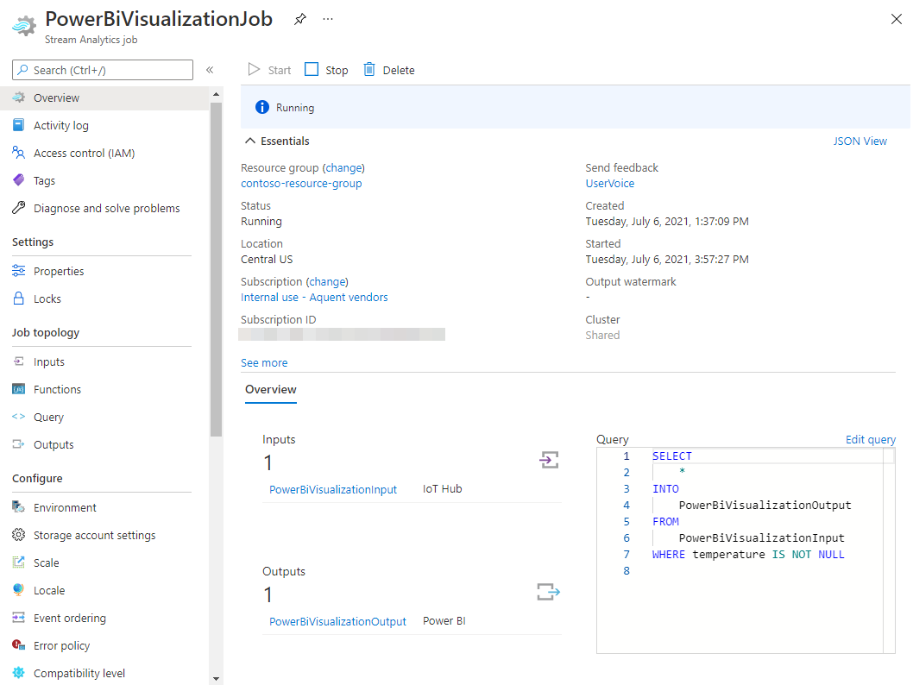
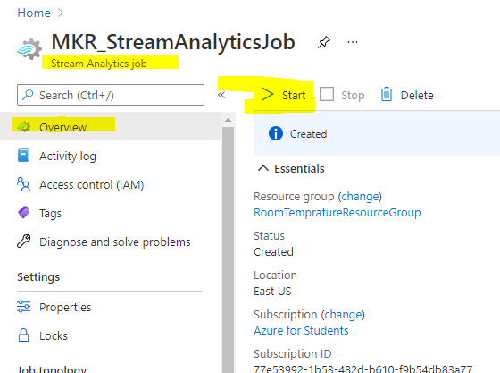
START the Stream Analytics job
In the Stream Analytics job, select Overview, then select Start > Now > Start. Once the job successfully starts, the job status changes from Stopped to Running.
Be Patient
Starting takes time
8
Notes:
https://docs.microsoft.com/en-us/azure/iot-hub/iot-hub-live-data-visualization-in-power-bi#run-the-stream-analytics-job
Run the Stream Analytics job
In the Stream Analytics job, select Overview, then select Start > Now > Start. Once the job successfully starts, the job status changes from Stopped to Running.

Slide 58
PowerBI Create Power BI report to visualize the data
Power BI is a business analytics service by Microsoft.
Business Intelligence (BI)
Notes:
https://docs.microsoft.com/en-us/azure/iot-hub/iot-hub-live-data-visualization-in-power-bi#create-and-publish-a-power-bi-report-to-visualize-the-data
Create and publish a Power BI report to visualize the data

Slide 59
What is Power BI?
https://youtu.be/yKTSLffVGbk
Notes:
https://youtu.be/yKTSLffVGbk

Slide 60
Create and publish a Power BI report to visualize the data
Make sure the client app is running on your device.
Sign in to your Power BI account and select Power BI service from the top menu.
https://powerbi.microsoft.com/
Select the workspace you used from the side menu, My Workspace.
Under the All tab or the Datasets + dataflows tab, you should see the dataset that you specified when you created the output for the Stream Analytics job.
https://powerbi.microsoft.com/

Slide 61
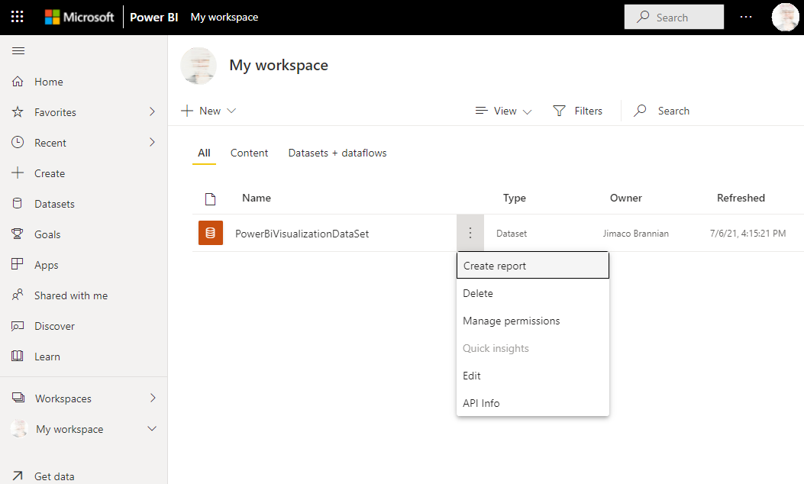
Hover over the dataset you created, select More options menu (the three dots to the right of the dataset name), and then select Create report.
Notes:
Create a line chart to show real-time temperature over time.
On the Visualizations pane of the report creation page, select the line chart icon to add a line chart. Use the guides located on the sides and corners of the chart to adjust its size and position.
On the Fields pane, expand the table that you specified when you created the output for the Stream Analytics job.
Drag EventEnqueuedUtcTime to Axis on the Visualizations pane.
Drag temperature to Values.
A line chart is created. The x-axis displays date and time in the UTC time zone. The y-axis displays temperature from the sensor.

Slide 62
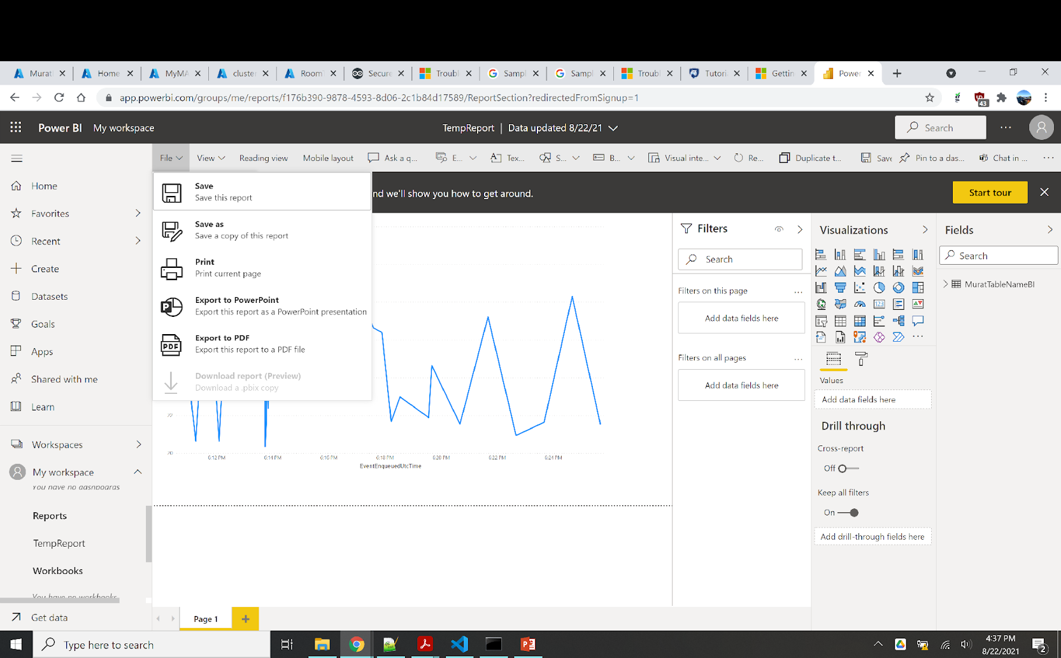
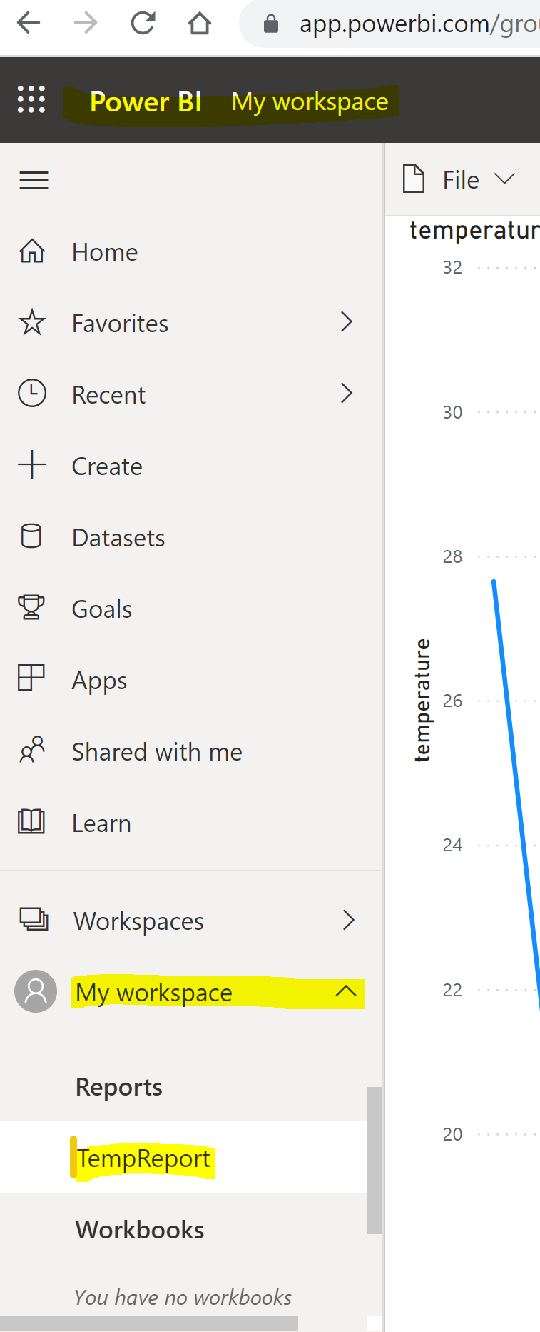
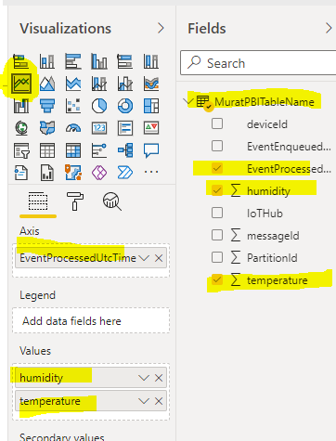
Power BI report to visualize the data

Slide 63
Cleanup resources

Slide 64
Cleaning Up Resources
You've created a resource group, an IoT hub, a Stream Analytics job, and a dataset in Power BI.
If you don't need the IoT hub or the other resources you created any longer, you can delete the resource group in the portal.
Clean up Power BI resources as well too
More Detail:
https://docs.microsoft.com/en-us/azure/iot-hub/iot-hub-live-data-visualization-in-power-bi#cleanup-resources
Notes:
https://docs.microsoft.com/en-us/azure/iot-hub/iot-hub-live-data-visualization-in-power-bi#cleanup-resources
In this tutorial, you've created a resource group, an IoT hub, a Stream Analytics job, and a dataset in Power BI.
If you plan to complete other tutorials, you may want to leave the resource group and IoT hub and reuse them later.
If you don't need the IoT hub or the other resources you created any longer, you can delete the resource group in the portal. To do so, select the resource group and then select Delete resource group. If you want to keep the IoT hub, you can delete other resources from the Overview pane of the resource group. To do so, right-click the resource, select Delete from the context menu, and follow the prompts.
Clean up Power BI resources
You created a dataset, PowerBiVisualizationDataSet, in Power BI. To remove it, sign in to your Power BI account. On the left-hand menu under Workspaces, select My workspace. In the list of datasets under the DataSets + dataflows tab, hover over the PowerBiVisualizationDataSet dataset. Select the three vertical dots that appear to the right of the dataset name to open the More options menu, then select Delete and follow the prompts. When you remove the dataset, the report is removed as well.

Slide 65
Want to Explore More

Slide 66


Good Tutorials:
How can we save telemetry an Azure SQL database?
https://www.mssqltips.com/sqlservertip/6335/how-to-capture-iot-data-in-azure/
IoT Azure Pipeline
https://paul-bruffett.medium.com/iot-azure-pipeline-9725ac2b6a00

Slide 67
More Application
Visualize real-time sensor data from your Azure IoT hub in a web application
https://docs.microsoft.com/en-us/azure/iot-hub/iot-hub-live-data-visualization-in-web-apps
Tutorial: Implement IoT spatial analytics by using Azure Maps
https://docs.microsoft.com/en-us/azure/azure-maps/tutorial-iot-hub-maps
Arduino IoT Cloud Google Sheets Integration
https://create.arduino.cc/projecthub/Arduino_Genuino/arduino-iot-cloud-google-sheets-integration-71b6bc

Slide 68
Some Terminology

Slide 69
Communicate with IoT Hub
Device to cloud (D2C) messages
– these are messages sent from a device to IoT Hub, such as telemetry. They can then be read off the IoT Hub by your application code.
Cloud to device (C2D) messages
- these are messages sent from application code, via an IoT Hub to an IoT device
Direct method requests
- these are messages sent from application code via an IoT Hub to an IoT device to request that the device does something, such as control an actuator. These messages require a response so your application code can tell if it was successfully processed.
Device twins
- these are JSON documents kept synchronized between the device and IoT Hub, and are used to store settings or other properties either reported by the device, or should be set on the device (known as desired) by the IoT Hub.
Notes:
Device to cloud (D2C) messages - these are messages sent from a device to IoT Hub, such as telemetry. They can then be read off the IoT Hub by your application code.
🎓 Under the hood, IoT Hub uses an Azure service called Event Hubs. When you write code to read messages sent to the hub, these are often called events.
Cloud to device (C2D) messages - these are messages sent from application code, via an IoT Hub to an IoT device
Direct method requests - these are messages sent from application code via an IoT Hub to an IoT device to request that the device does something, such as control an actuator. These messages require a response so your application code can tell if it was successfully processed.
Device twins - these are JSON documents kept synchronized between the device and IoT Hub, and are used to store settings or other properties either reported by the device, or should be set on the device (known as desired) by the IoT Hub.

Slide 70
Extra Information: Device Provisioning Service

Slide 71
Azure IoT Hub Device Provisioning Service (DPS)
Link IoT Device Provisioning Service and IoT hub so that the IoT Hub Device Provisioning Service can register devices to that hub
How to link an IoT hub
Set up allocation policy, which is a IoT Hub Device Provisioning Service setting that determines how devices are assigned to an IoT hub
How to set up an allocation policy
Add the device's unique security artifacts to the Device Provisioning Service
How to enroll device
Start the device to allow your client application to start the registration with your Device Provisioning service
How to start and verify a device
Notes:
https://docs.microsoft.com/en-us/azure/iot-dps/?WT.mc_id=Portal-Microsoft_Azure_IotHub

Slide 72
QuickStart: Set up the IoT Hub Device Provisioning Service with the Azure portal
Link the IoT hub and your Device Provisioning Service
https://docs.microsoft.com/en-us/azure/iot-dps/quick-setup-auto-provision#link-the-iot-hub-and-your-device-provisioning-service
Azure IoT Hub Device Provisioning Service (DPS) Documentation
https://docs.microsoft.com/en-us/azure/iot-dps/quick-create-simulated-device-x509
https://docs.microsoft.com/en-us/azure/iot-dps/quick-setup-auto-provision
Notes:
https://docs.microsoft.com/en-us/azure/iot-dps/quick-setup-auto-provision
https://docs.microsoft.com/en-us/azure/iot-dps/

Slide 73
IoT Hub DPS Demo
View a demo of an IoT device being automatically provisioned, in a secure and scalable way, with IoT Hub Device Provisioning Service. You’ll understand how you can provision thousands of IoT devices with zero-touch.
Click to watch the video
https://azure.microsoft.com/en-us/resources/videos/iot-hub-dps-demo/
Quickstart: Set up the IoT Hub Device Provisioning Service with Azure CLI
https://docs.microsoft.com/en-us/azure/iot-dps/quick-setup-auto-provision-cli
Notes:
https://azure.microsoft.com/en-us/resources/videos/iot-hub-dps-demo/

Slide 74
References
IoT Azure Pipeline
https://paul-bruffett.medium.com/iot-azure-pipeline-9725ac2b6a00
Securely Connecting an Arduino NB 1500 to Azure IoT Hub © CC BY
https://create.arduino.cc/projecthub/Arduino_Genuino/securely-connecting-an-arduino-nb-1500-to-azure-iot-hub-af6470
Securely Connecting an Arduino MKR WiFi 1010 to AWS IoT Core
https://create.arduino.cc/projecthub/Arduino_Genuino/securely-connecting-an-arduino-mkr-wifi-1010-to-aws-iot-core-a9f365
Quickstart: Create a Stream Analytics job by using the Azure portal
https://docs.microsoft.com/en-us/azure/stream-analytics/stream-analytics-quick-create-portal
Tutorial: Visualize real-time sensor data from Azure IoT Hub using Power BI
https://docs.microsoft.com/en-us/azure/iot-hub/iot-hub-live-data-visualization-in-power-bi
Some more in the notes section of these slides.

Slide 75
Thanks!
Any questions?
Let us dare!
Notes:
Murat K Gungor

Slide 76
These could be useful Most likely you will not need for this class

Slide 77


Adding a device PAUSE! First we need device certification
IoT device connects to your IoT Hub using Certification
Pause Here!
To complete this we need to jump to next steps to create our certification
X.509 Certificates
Needed
Notes:
az iot hub device-identity connection-string show --device-id soil-moisture-sensor \ --output table \ --hub-name <hub_name>
Replace <hub_name> with the name you used for your IoT Hub.
https://github.com/microsoft/IoT-For-Beginners/blob/main/2-farm/lessons/4-migrate-your-plant-to-the-cloud/README.md#task---register-your-iot-device

Slide 78

Create a device
When your IoT device connects to your IoT Hub using the SDK, it needs to use a connection string that gives the URL of the hub, along with a secret key.
Notes:
az iot hub device-identity connection-string show --device-id soil-moisture-sensor \ --output table \ --hub-name <hub_name>
Replace <hub_name> with the name you used for your IoT Hub.
https://github.com/microsoft/IoT-For-Beginners/blob/main/2-farm/lessons/4-migrate-your-plant-to-the-cloud/README.md#task---register-your-iot-device

Slide 79

Connection String
Store the connection string that is shown in the output as you will need it later.
Notes:
HostName=RoomTempHub.azure-devices.net;DeviceId=MyArduinoMKR1010-DeviceID;SharedAccessKey=jS4m+FHc+17l4+dKuNGzaYNs6bZH95dkg0XuqeoE0yM=
az iot hub device-identity connection-string show --device-id soil-moisture-sensor \ --output table \ --hub-name <hub_name>
az iot hub device-identity connection-string show --device-id MyArduinoMKR1010-DeviceID --output table --hub-name RoomTempHub
az iot hub monitor-events --hub-name <hub_name>
az iot hub monitor-events --hub-name RoomTempHub

Slide 80
Creating Certification for your Arduino

Slide 81
X.509 certificates for authentication
Azure IoT Hub allows devices that connect using the MQTT protocol and use X.509 certificates for authentication.
We'll use a sketch to generate a self signed X.509 Certificate on the board and then add the SHA1 of this certificate to Azure IoT Hub portal.
Every Arduino MKR board with on-board connectivity is equipped with a Microchip crypto element. This crypto element can be used to securely generate and store a 256-bit ECC (Elliptic Curve Cryptography) key.
Notes:
Ref:
Every Arduino MKR board with on-board connectivity is equipped with a Microchip ATECC508A or ATECC608A crypto element.
https://create.arduino.cc/projecthub/Arduino_Genuino/securely-connecting-an-arduino-nb-1500-to-azure-iot-hub-af6470
https://create.arduino.cc/projecthub/Arduino_Genuino/securely-connecting-an-arduino-mkr-wifi-1010-to-aws-iot-core-a9f365
As mentioned above, Azure IoT Hub allows devices that connect using the MQTT protocol and use X.509 certificates for authentication. We'll use a sketch to generate a self signed X.509 Certificate on the board and then add the SHA1 of this certificate to Azure IoT Hub portal.
The self signed certificate can be generated using an example sketch from the ArduinoECCX08 library. Open the sketch in the Arduino IDE using the File -> Examples -> ArduinoECCX08 -> Tools -> ECCX08SelfSignedCert. Click the "Upload" button to build and upload the sketch to your board, then open the Serial Monitor. Make sure the line ending configuration is set to "Both NL & CR."
This sketch will prompt you to permanently configure your ATECC508A to ECC608A crypto element if it is not configured and locked. NOTE: This locking process is permanent and irreversible, but is needed to use the the crypto element - the configuration the sketch sets allows to use 5 private key slots with any cloud provider(orserver) and a private keycan be regenerated any time for any of the 5 private key slots (0 - 4). When the board is shipped from the factory, the crypto element is in an unconfigured and unlocked state.
After this, you will be prompted for information to include in the self signed certificate, including the issue year, month, day and hour of the certificate and the expiry period in years. For this tutorial we'll be using slot 0 to generate and store the private key used to sign the self signed certificate (slots 1 to 4 can be used to generate and store additional private keys if needed) - then slot 8 will be used to store the issue and expiry date of the certificate along with it's signature. Note: Since the private key is generated inside the crypto element it never leaves the device and is stored securely and cannot be read.

Slide 82

Libraries to Install
We will install the Arduino libraries that will be used, using the Arduino IDE's library manager.
Open the Sketch -> Include Library -> Manage Libraries... menu, search for and individually install each of the following libraries:
Libraries
ArduinoBearSSL
ArduinoECCX08
ArduinoMqttClient
Arduino Cloud Provider Examples
Notes:
Securely Connecting an Arduino NB 1500 to Azure IoT Hub
https://create.arduino.cc/projecthub/Arduino_Genuino/securely-connecting-an-arduino-nb-1500-to-azure-iot-hub-af6470

Slide 83


X.509 certificates for authentication
The self signed certificate can be generated using an example sketch from the ArduinoECCX08 library.
“Open” the sketch in the Arduino IDE using the
File \
Examples \
ArduinoECCX08 \
Tools \
ECCX08SelfSignedCert
Click the "Upload" button to build and upload the sketch to your board, then open the Serial Monitor.
Notes:
Ref:
https://create.arduino.cc/projecthub/Arduino_Genuino/securely-connecting-an-arduino-nb-1500-to-azure-iot-hub-af6470
https://create.arduino.cc/projecthub/Arduino_Genuino/securely-connecting-an-arduino-mkr-wifi-1010-to-aws-iot-core-a9f365
As mentioned above, Azure IoT Hub allows devices that connect using the MQTT protocol and use X.509 certificates for authentication. We'll use a sketch to generate a self signed X.509 Certificate on the board and then add the SHA1 of this certificate to Azure IoT Hub portal.
The self signed certificate can be generated using an example sketch from the ArduinoECCX08 library. Open the sketch in the Arduino IDE using the File -> Examples -> ArduinoECCX08 -> Tools -> ECCX08SelfSignedCert. Click the "Upload" button to build and upload the sketch to your board, then open the Serial Monitor. Make sure the line ending configuration is set to "Both NL & CR."
This sketch will prompt you to permanently configure your ATECC508A to ECC608A crypto element if it is not configured and locked. NOTE: This locking process is permanent and irreversible, but is needed to use the the crypto element - the configuration the sketch sets allows to use 5 private key slots with any cloud provider(orserver) and a private keycan be regenerated any time for any of the 5 private key slots (0 - 4). When the board is shipped from the factory, the crypto element is in an unconfigured and unlocked state.
After this, you will be prompted for information to include in the self signed certificate, including the issue year, month, day and hour of the certificate and the expiry period in years. For this tutorial we'll be using slot 0 to generate and store the private key used to sign the self signed certificate (slots 1 to 4 can be used to generate and store additional private keys if needed) - then slot 8 will be used to store the issue and expiry date of the certificate along with it's signature. Note: Since the private key is generated inside the crypto element it never leaves the device and is stored securely and cannot be read.

Slide 84
After this, you will be prompted for information to include in the self signed certificate, including the issue year, month, day and hour of the certificate and the expiry period in years.
For this tutorial we'll be using
slot 0 to generate and store the private key used to sign the self signed certificate (slots 1 to 4 can be used to generate and store additional private keys if needed) - then
slot 8 will be used to store the issue and expiry date of the certificate along with its signature.

Slide 85
Serial Port – Enter the data requested
ECCX08 Serial Number = 012385338ACB4748EE
Hi there, in order to generate a new self signed cert for your board, we'll need the following information ...
Please enter the issue year of the certificate? (2000 - 2031) [2019]: 2021
Please enter the issue month of the certificate? (1 - 12) [1]: 8
Please enter the issue day of the certificate? (1 - 31) [1]: 18
Please enter the issue hour of the certificate? (0 - 23) [0]: 11
Please enter how many years the certificate is valid for? (1 - 31) [31]: 11
What slot would you like to use for the private key? (0 - 4) [0]: 0
What slot would you like to use for storage? (8 - 15) [8]: 8
Would you like to generate a new private key? (Y/n) [Y]: Y
Here's your self signed cert, enjoy!

Slide 86

Serial Monitor – Executing
DON’T
CLOSE
Copy everything
Save into a text file for further processing
Use Notepad++
Note: Since the private key is generated inside the crypto element it never leaves the device and is stored securely and cannot be read.
SHA1 KEY
Notes:
ECCX08 Serial Number = 0123324CA129AFBEEE
Hi there, in order to generate a new self signed cert for your board, we'll need the following information ...
Please enter the issue year of the certificate? (2000 - 2031) [2019]: 2021
Please enter the issue month of the certificate? (1 - 12) [1]: 11
Please enter the issue day of the certificate? (1 - 31) [1]: 1
Please enter the issue hour of the certificate? (0 - 23) [0]: 1
Please enter how many years the certificate is valid for? (1 - 31) [31]: 10
What slot would you like to use for the private key? (0 - 4) [0]: 1
What slot would you like to use for storage? (8 - 15) [8]: 11
Would you like to generate a new private key? (Y/n) [Y]: Y
Here's your self signed cert, enjoy!
-----BEGIN CERTIFICATE-----
MIIBKjCB0aADAgECAgEBMAoGCCqGSM49BAMCMB0xGzAZBgNVBAMTEjAxMjMzMjRDQTEyOUFGQkVF
RTAeFw0yMTExMDEwMTAwMDBaFw0zMTExMDEwMTAwMDBaMB0xGzAZBgNVBAMTEjAxMjMzMjRDQTEy
OUFGQkVFRTBZMBMGByqGSM49AgEGCCqGSM49AwEHA0IABJB/FSRXdcI4KcQwPgaxiL2pVu2LLVVy
7IkwOLD7m/pwiIn57EouI5ossuK52sZ1GAlmN8IBBI0I5gRjSl3+flOjAjAAMAoGCCqGSM49BAMC
A0gAMEUCIGfwZHHVGAgN8EKhQmy7vCDDfYcr5eqW6utP+szGnjTUAiEA1sC1jiqZEuNg5E5FEuE0
hnhMtZ/M70GNSHzOqiOoVa4=
-----END CERTIFICATE-----
SHA1: e2ae6f4f8dea237ec47cc6ceb5bf013f19604663

Slide 87
Sample Run Output
-----BEGIN CERTIFICATE-----
MIIBKjCB0aADAgECAgEBMAoGCCqGSM49BAMCMB0xGzAZBgNVBAMTEjAxMjM4NTMzOEFDQjQ3NDhF
RTAeFw0yMTA4MTgxMTAwMDBaFw0zMjA4MTgxMTAwMDBaMB0xGzAZBgNVBAMTEjAxMjM4NTMzOEFD
QjQ3NDhFRTBZMBMGByqGSM49AgEGCCqGSM49AwEHA0IABDJ7ddEvDvp7eVK6gp2dCyGNMN0N0re0
WpBofjzOMcOYbWGTiOZeQtoUghi4lle3avK1Im9WV67/0nlysTgeSFWjAjAAMAoGCCqGSM49BAMC
A0gAMEUCIQCObICMKzAMcASi0maa/P9hW8UXvsurk2whrljxQEbdVgIgeFrzdnFjWhJR7BFyKBek
TlqW0q7BYfTSQkD3/YIg7cg=DONT
-----END CERTIFICATE-----
From Your Serial Port:
Save the above text in orange color to ECCX08cert.pem (You can name the file anything but keep the extension)
SHA1: 630a8758e2b86c29aef35f56546f390b676035DONTfb
We need this blue key while adding our device to Azure Cloud
Notes:
Copy the generated SHA1 value
We will use it in a later step as a fingerprint for the self signed certificate for the device in Azure IoT Hub.
Here's your self signed cert, enjoy!
-----BEGIN CERTIFICATE-----
MIIBKjCB0aADAgECAgEBMAoGCCqGSM49BAMCMB0xGzAZBgNVBAMTEjAxMjMzMjRDQTEyOUFGQkVF
RTAeFw0yMTExMDEwMTAwMDBaFw0zMTExMDEwMTAwMDBaMB0xGzAZBgNVBAMTEjAxMjMzMjRDQTEy
OUFGQkVFRTBZMBMGByqGSM49AgEGCCqGSM49AwEHA0IABJB/FSRXdcI4KcQwPgaxiL2pVu2LLVVy
7IkwOLD7m/pwiIn57EouI5ossuK52sZ1GAlmN8IBBI0I5gRjSl3+flOjAjAAMAoGCCqGSM49BAMC
A0gAMEUCIGfwZHHVGAgN8EKhQmy7vCDDfYcr5eqW6utP+szGnjTUAiEA1sC1jiqZEuNg5E5FEuE0
hnhMtZ/M70GNSHzOqiOoVa4=
-----END CERTIFICATE-----
SHA1: e2ae6f4f8dea237ec47cc6ceb5bf013f19604663

Slide 88
Go back to Azure to Add our Device

Slide 89
Create a device
When your IoT device connects to your IoT Hub using Certification
SHA1 KEY
Notes:
az iot hub device-identity connection-string show --device-id soil-moisture-sensor \ --output table \ --hub-name <hub_name>
Replace <hub_name> with the name you used for your IoT Hub.
https://github.com/microsoft/IoT-For-Beginners/blob/main/2-farm/lessons/4-migrate-your-plant-to-the-cloud/README.md#task---register-your-iot-device

Slide 90

Device Added to Azure Cloud
Notes:
az iot hub device-identity connection-string show --device-id soil-moisture-sensor \ --output table \ --hub-name <hub_name>
Replace <hub_name> with the name you used for your IoT Hub.
https://github.com/microsoft/IoT-For-Beginners/blob/main/2-farm/lessons/4-migrate-your-plant-to-the-cloud/README.md#task---register-your-iot-device

Slide 91
Code Part at Arduino

Slide 92


Open This Example Code
Open
Azure Examples /
Arduino Cloud Provider Examples /
Azure IoT Hub /
Azure IoT Hub WiFi

Slide 93

Visual Studio Code

Slide 94

My Sample Run at Serial Monitor
#define MQTT_CONNECTION_REFUSED -2
#define MQTT_CONNECTION_TIMEOUT -1
#define MQTT_SUCCESS 0
#define MQTT_UNACCEPTABLE_PROTOCOL_VERSION 1
#define MQTT_IDENTIFIER_REJECTED 2
#define MQTT_SERVER_UNAVAILABLE 3
#define MQTT_BAD_USER_NAME_OR_PASSWORD 4
#define MQTT_NOT_AUTHORIZED 5
Notes:
https://docs.microsoft.com/en-us/azure/iot-hub/tutorial-x509-scripts
https://paul-bruffett.medium.com/iot-azure-pipeline-9725ac2b6a00

Slide 95




Using JSON format
Publishing message
{
"messageId":968,
"deviceId":"MKR WiFI 1010 Client",
"temperature":28.24657,
"humidity":70.85092
}
Visual Studio Code

Slide 96



Slide 97


Azure Settings

